Slide 1

GRANDstack: Graphs ALL The Way Down
William Lyon @lyonwj
lyonwj.com
bit.ly/GRANDstack

Slide 2
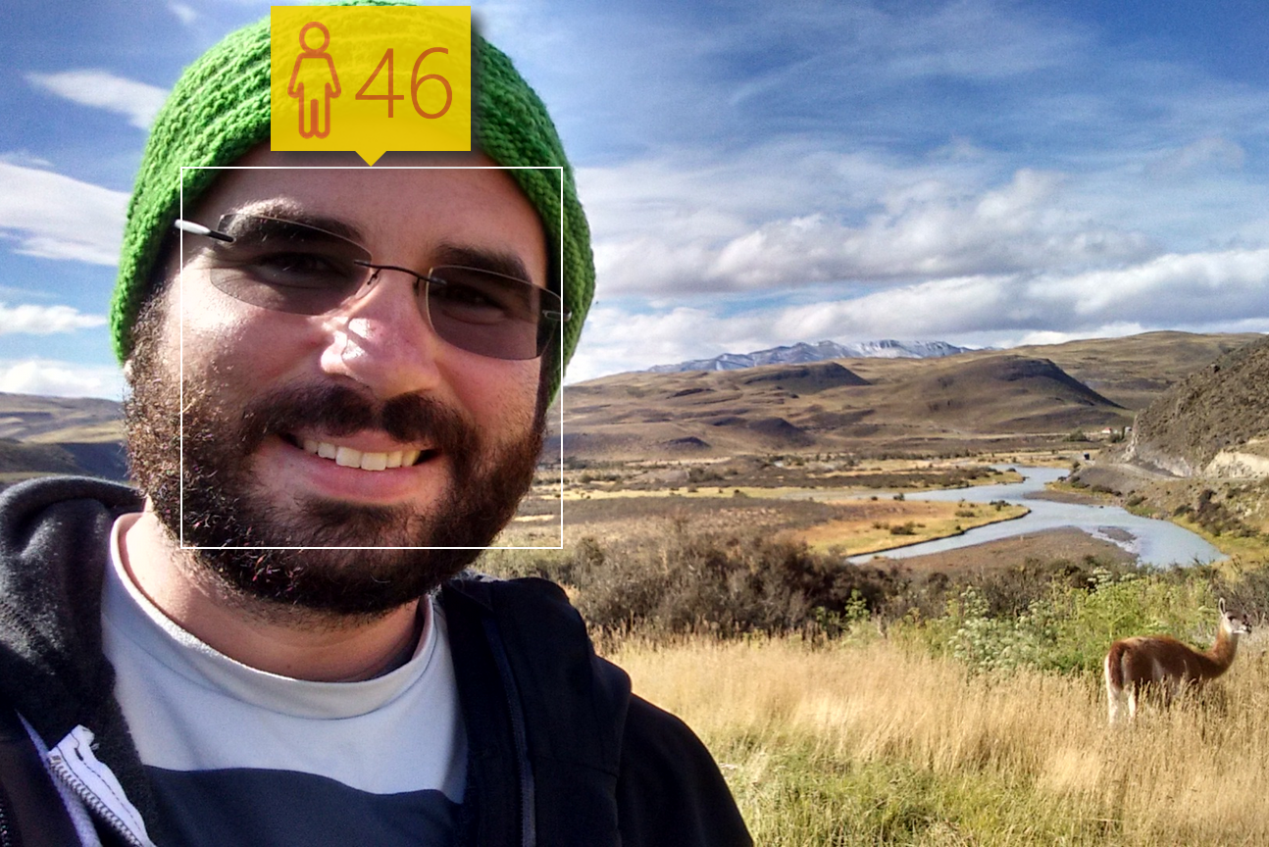
William Lyon
@lyonwj
Neo4j Labs Engineer

Slide 3

Agenda
What’s a GRANDstack?
Building a #NODES2019 Recommendations App
Hunger Games

Slide 4
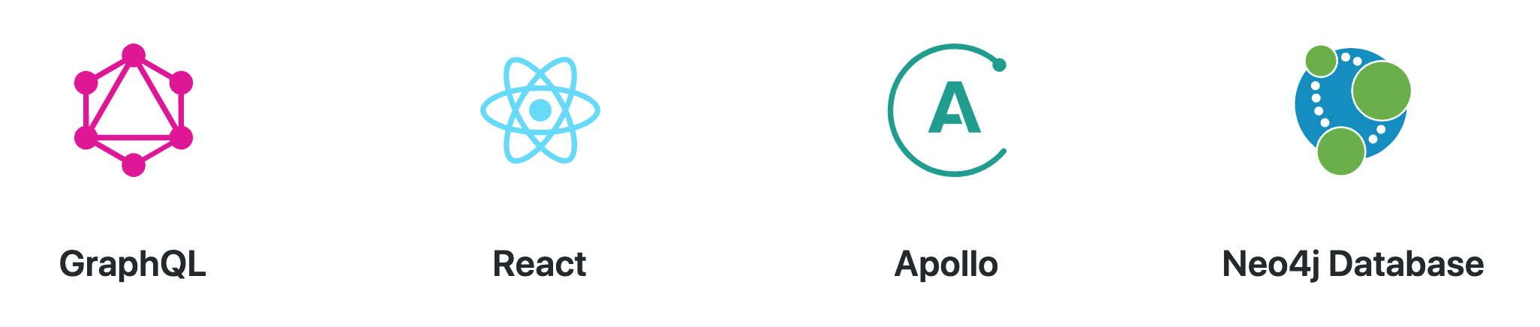
Fullstack GraphQL with GRANDstack
Fullstack framework for building applications
grandstack.io

Slide 5
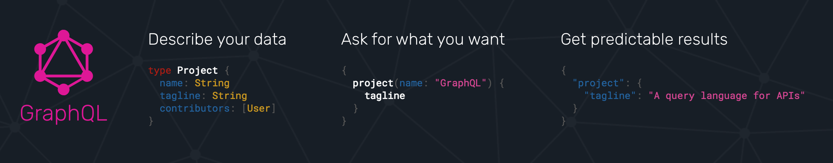
What is GraphQL?
An API query language and runtime for building APIs
GraphQL.org

Slide 6
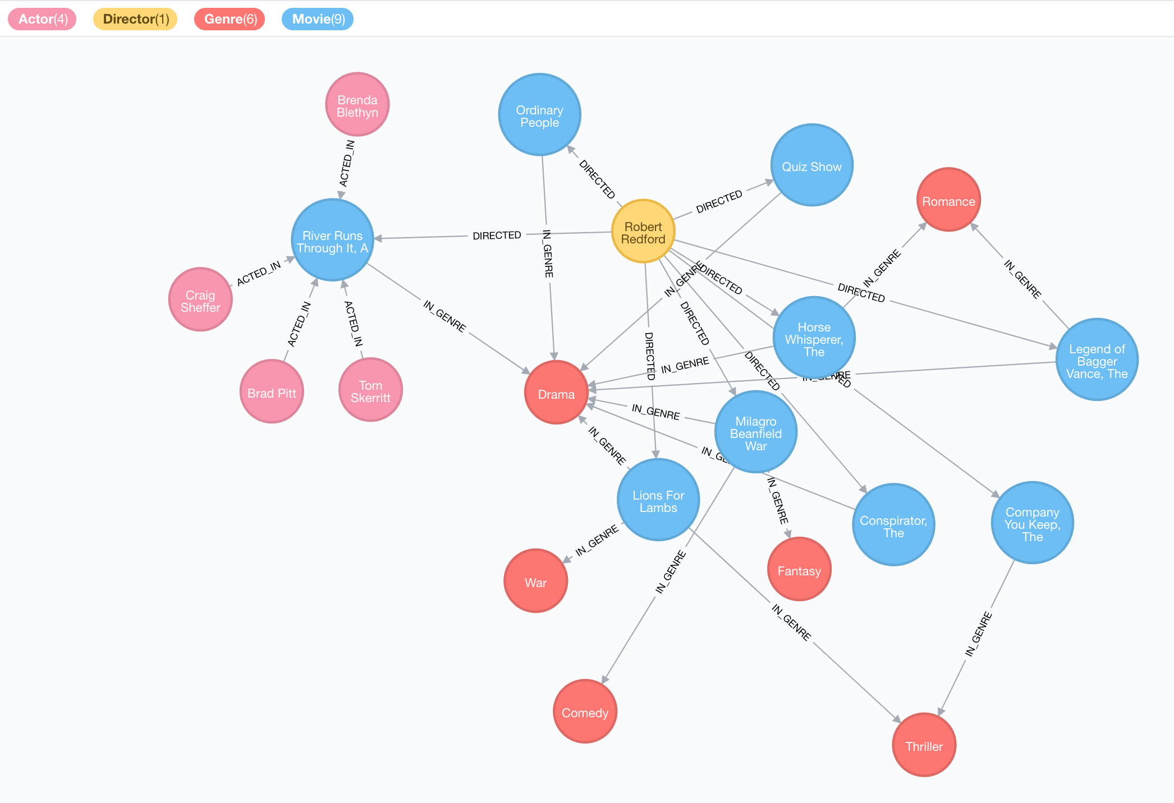
“Your Application Data Is A Graph”
-- GraphQL

Slide 7
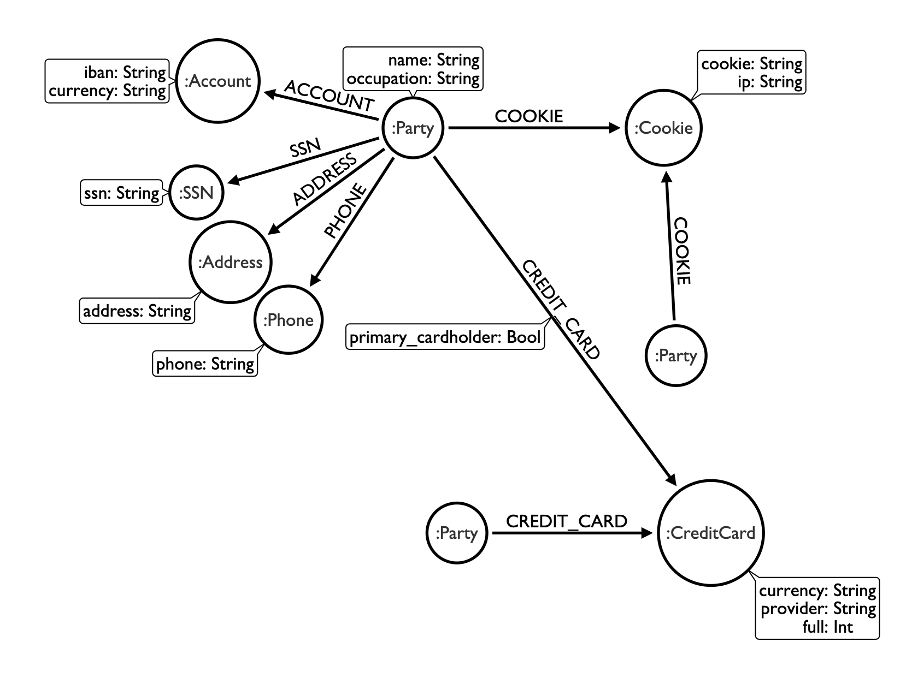
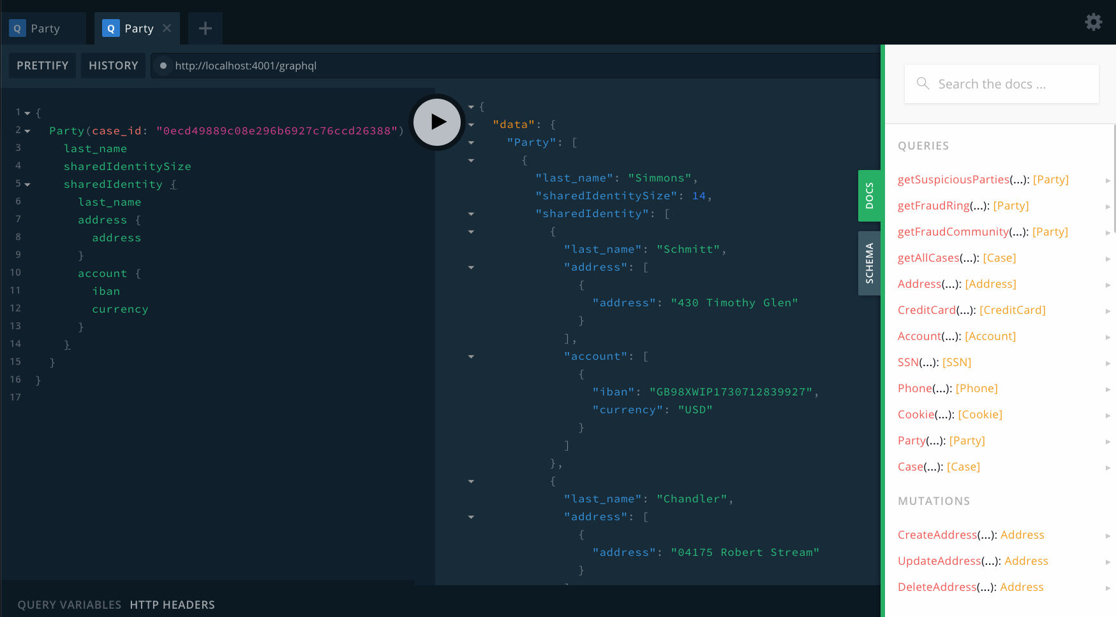

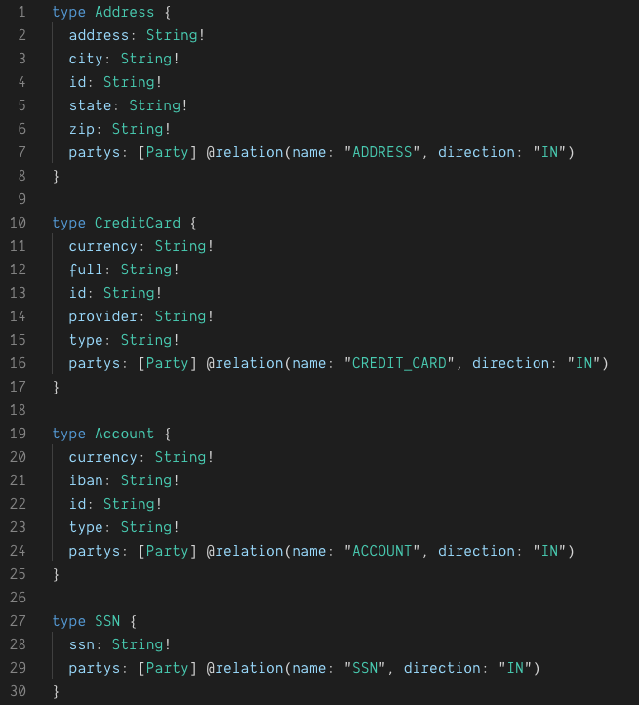
Expose A GraphQL API From Neo4j
GRANDstack.io

Slide 8
Fullstack GraphQL with GRANDstack
Fullstack framework for building applications
grandstack.io

Slide 9
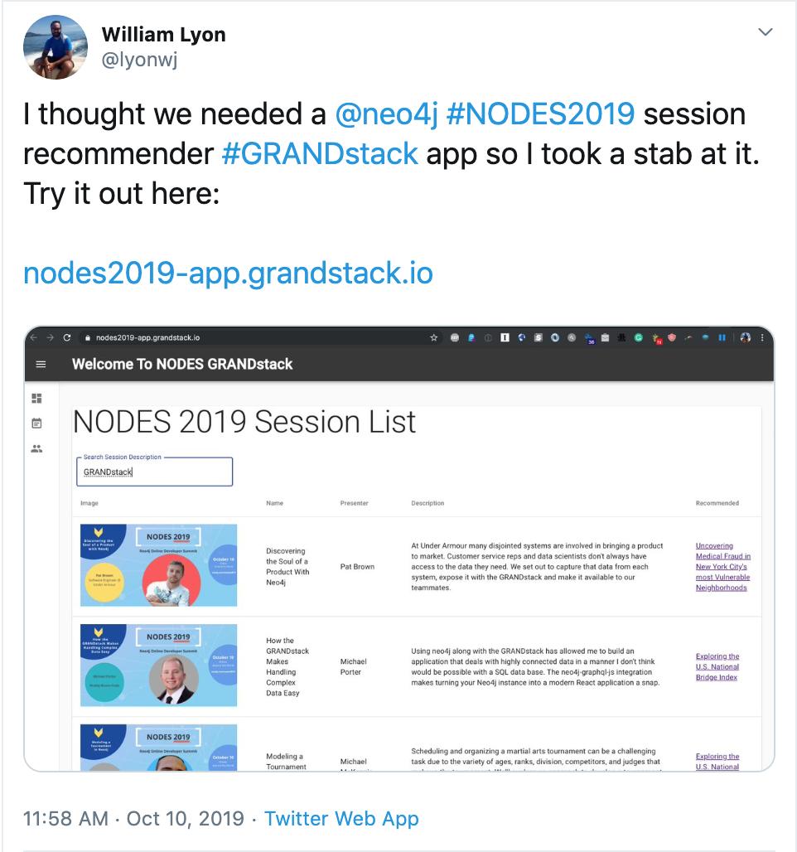
nodes2019-app.grandstack.io

Slide 10
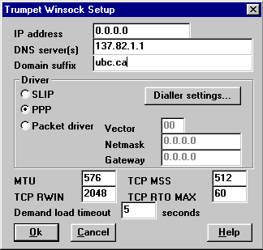
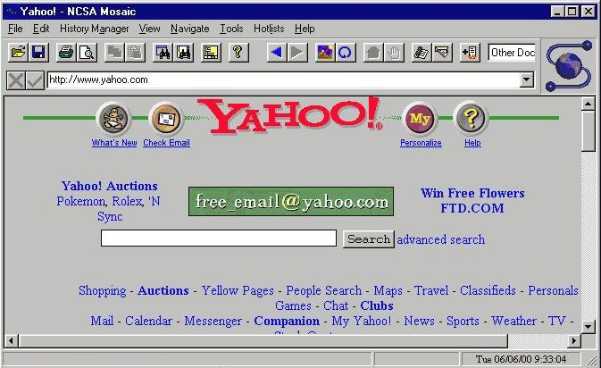
Evolution of Web Dev
Mid 1990s:
Static HTML
CGI and PHP
LAMP Stack
~2000s:
REST APIs, JSON
jQuery
~2010s:
NoSQL
MEAN Stack
Meteor.js

Slide 11
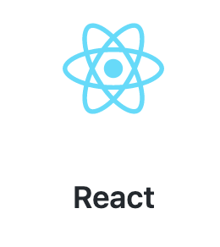
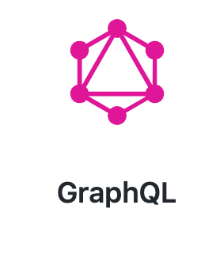
Evolution of Web Dev
2010s to...
React (open sourced in 2013)
Mental model of server side JS to client
Move from event listeners to declarative actions about state
Virtual DOM
GraphQL (open sourced in 2015)
Efficient data fetching
Data type system - describe and query your API as a graph
Graph databases
Intuitive graph datamodel
Native graph query performance
Deployment, serverless, DX over Cloud services

Slide 12
“Your Application Data Is A Graph”
-- GraphQL

Slide 13
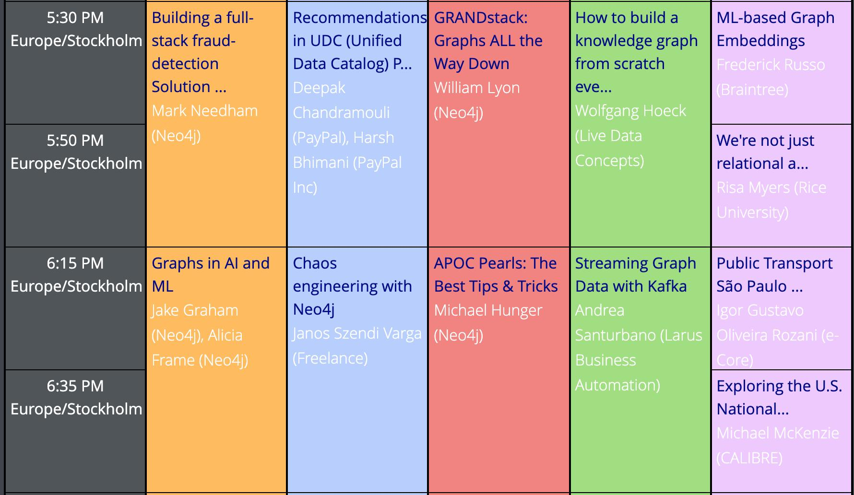
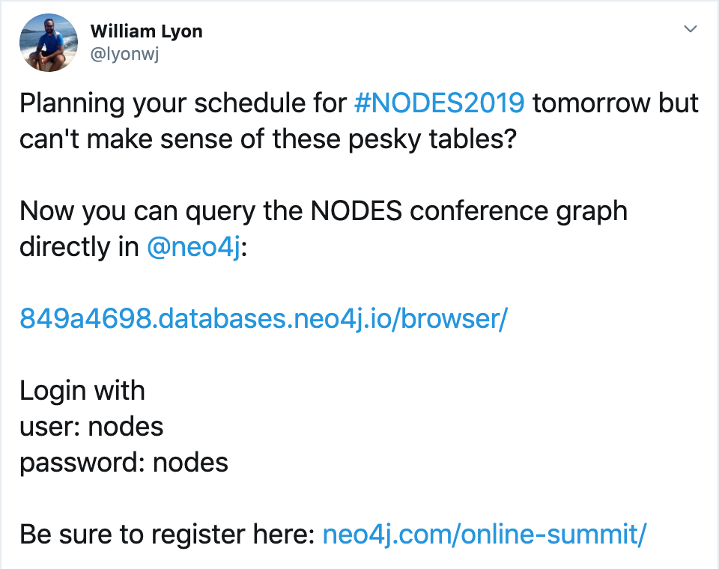
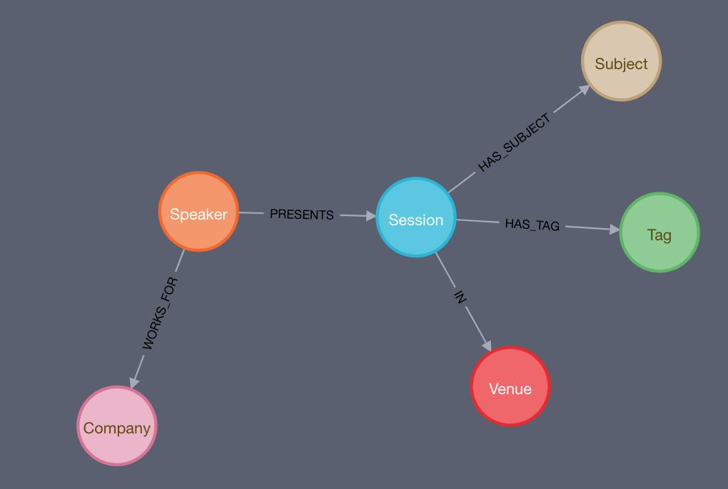
NODES Conference Graph
849a4698.databases.neo4j.io/browser/

Slide 14
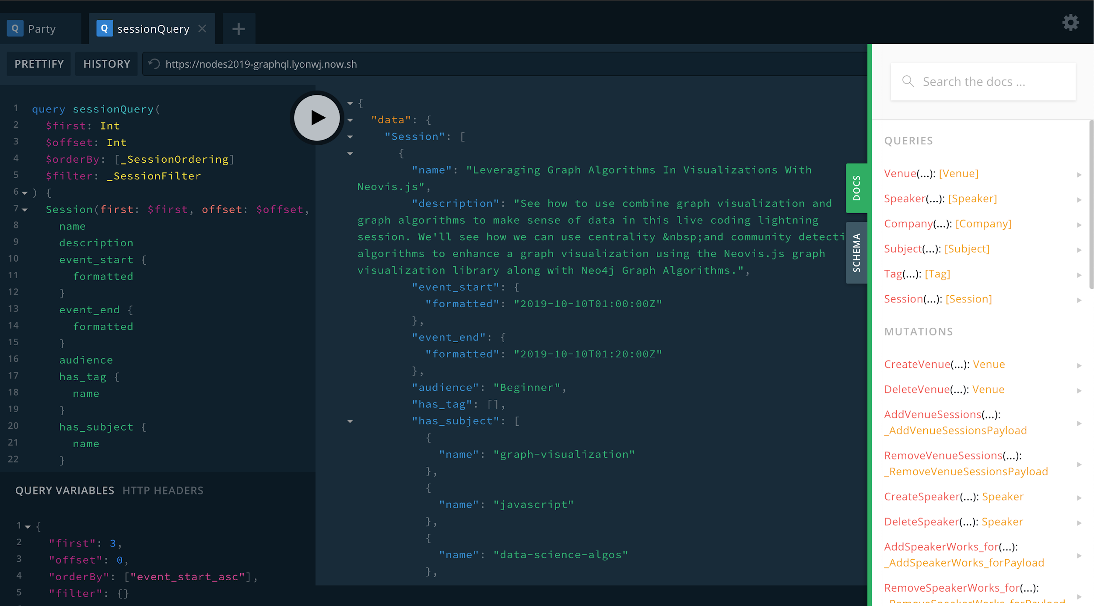
NODES Schedule GraphQL API
nodes2019.grandstack.io

Slide 15
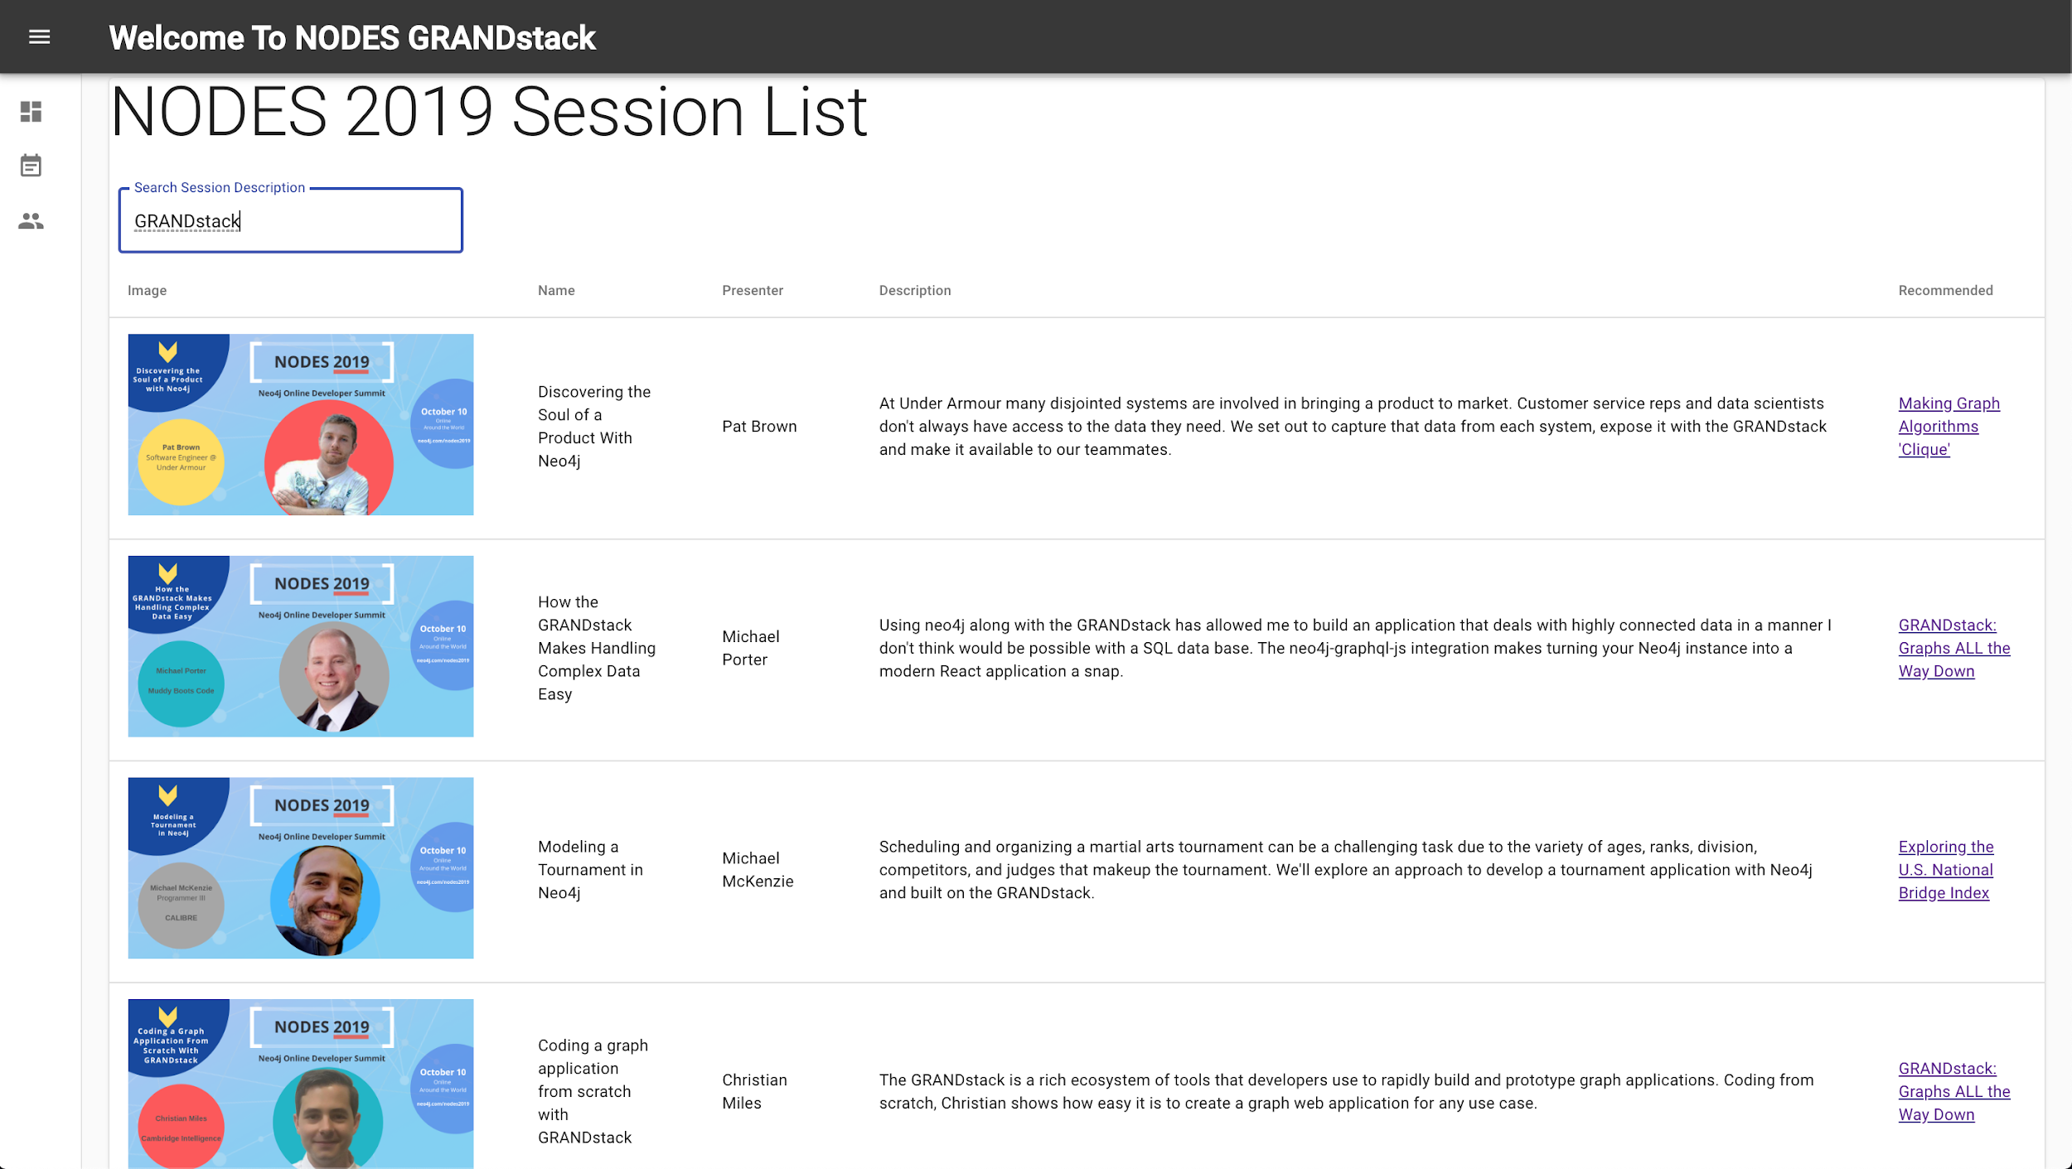
NODES Schedule React App
TODO: FIXME

Slide 16
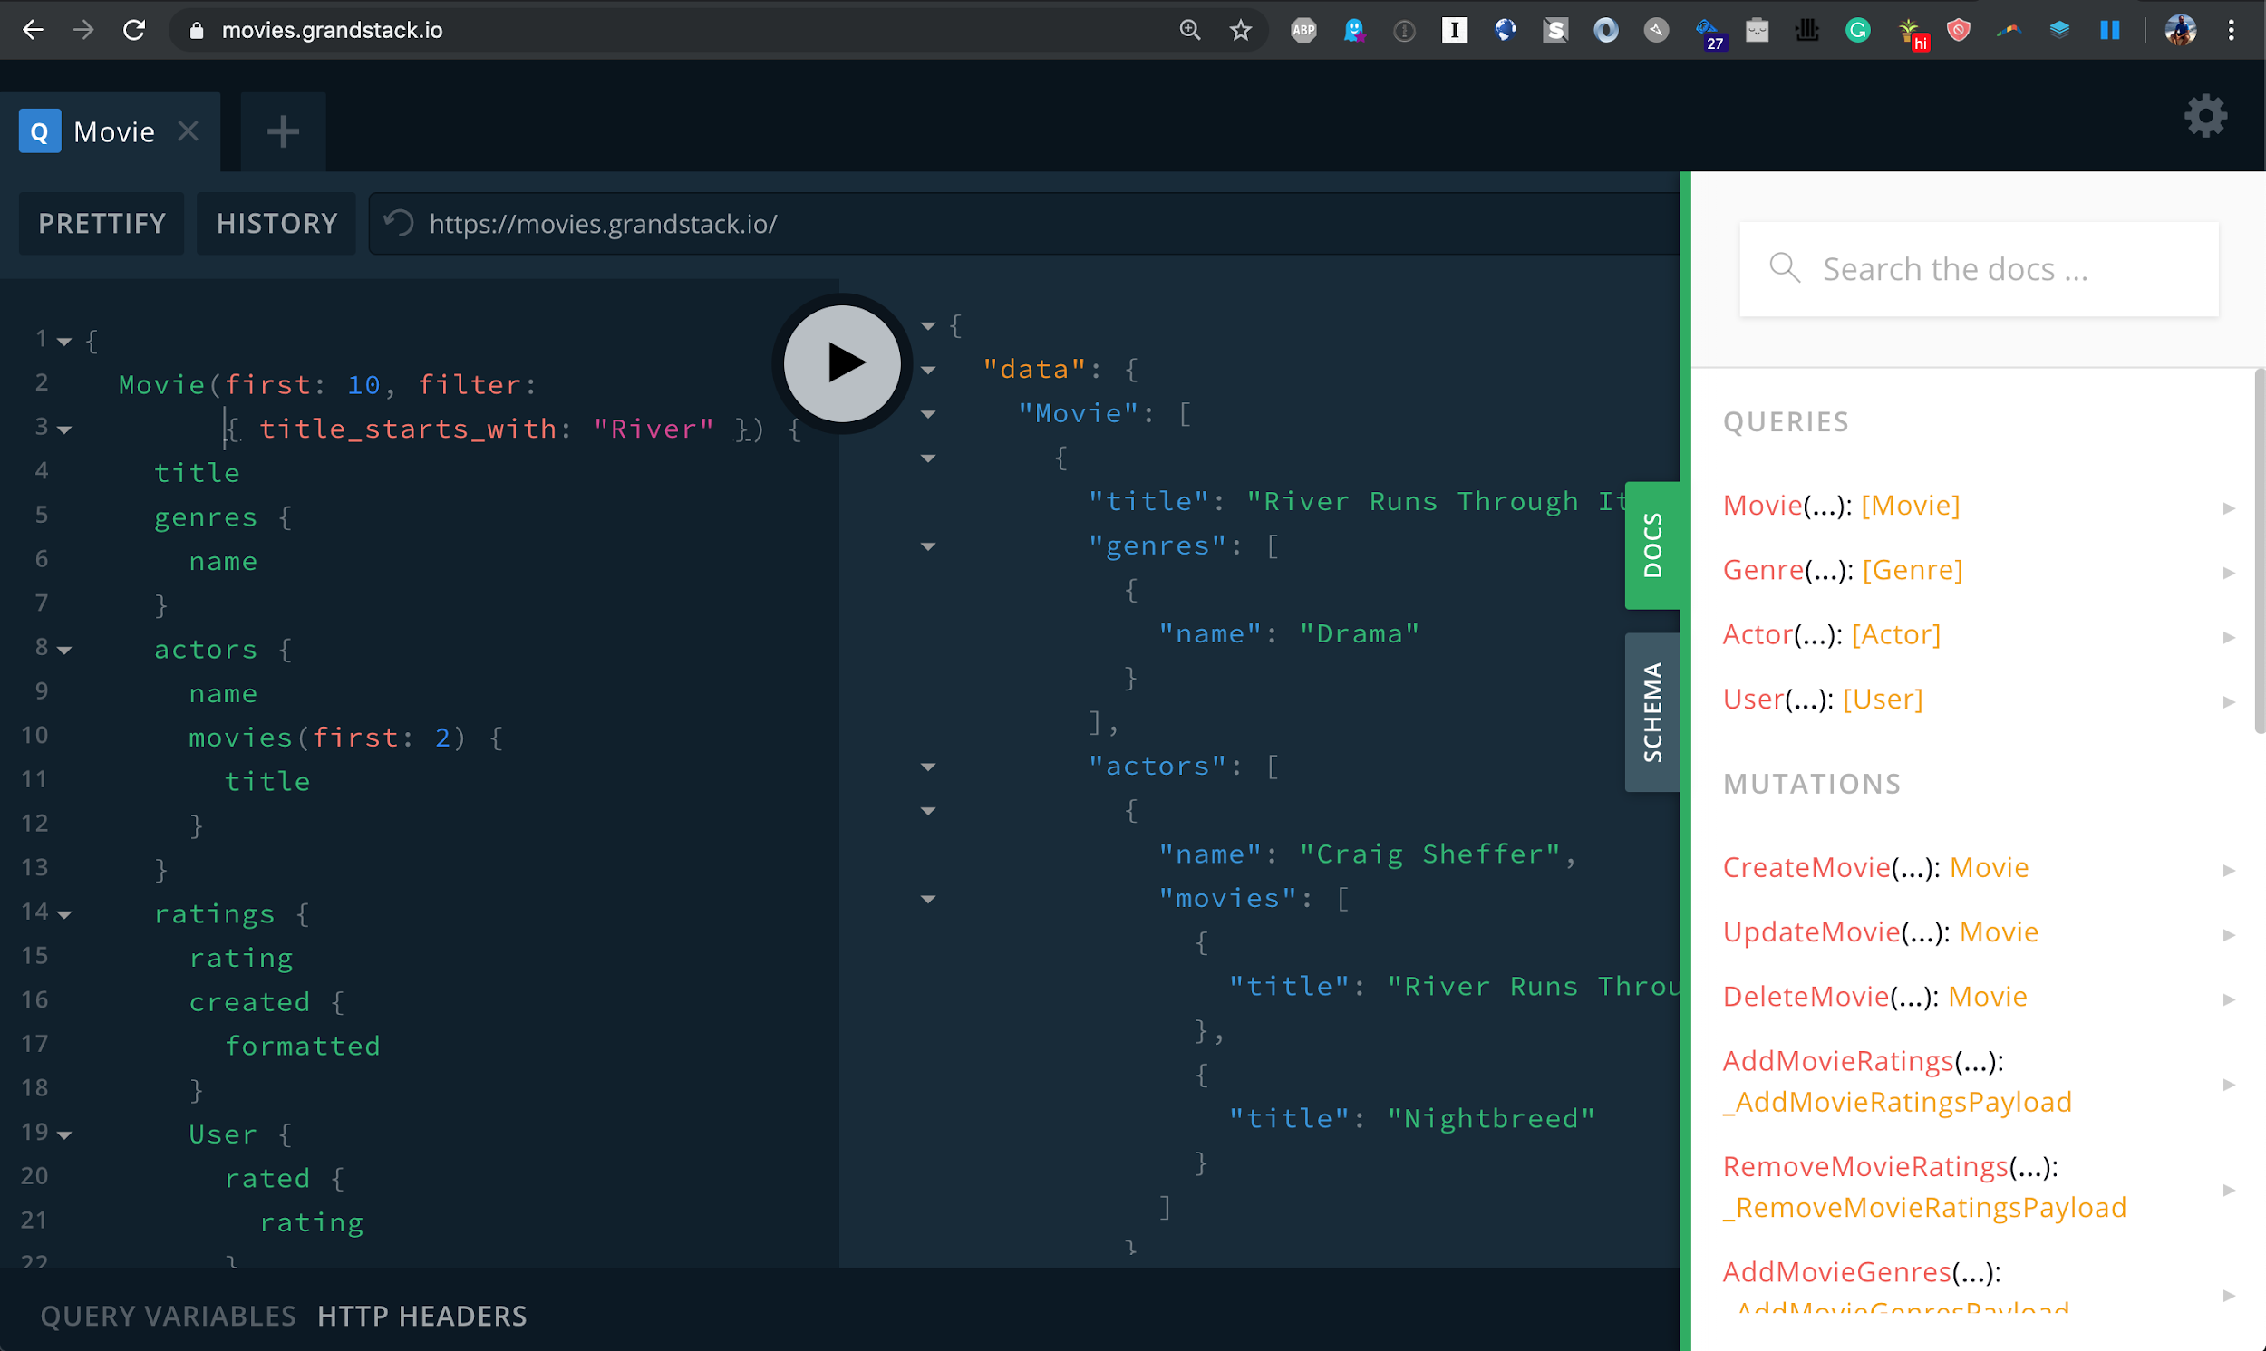
movies.grandstack.io

Slide 17
Movies, Genres, Directors, Actors
@lyonwj
Notes:
MATCH (m:Movie) WHERE m.title CONTAINS "River Runs Through It"
MATCH (m)-[:IN_GENRE]->(g:Genre)
MATCH (m)<-[:DIRECTED]-(d:Director)-[:DIRECTED]->(o:Movie)
MATCH (m)<-[:ACTED_IN]-(a:Actor)
MATCH (o)-[:IN_GENRE]->(go:Genre)
RETURN *
{
Movie(title: "River Runs Through It, A") {
title
actedIn(first: 2) {
name
}
inGenre {
name
}
directed {
name
directed(first: 3) {
title
}
}
}
}

Slide 18
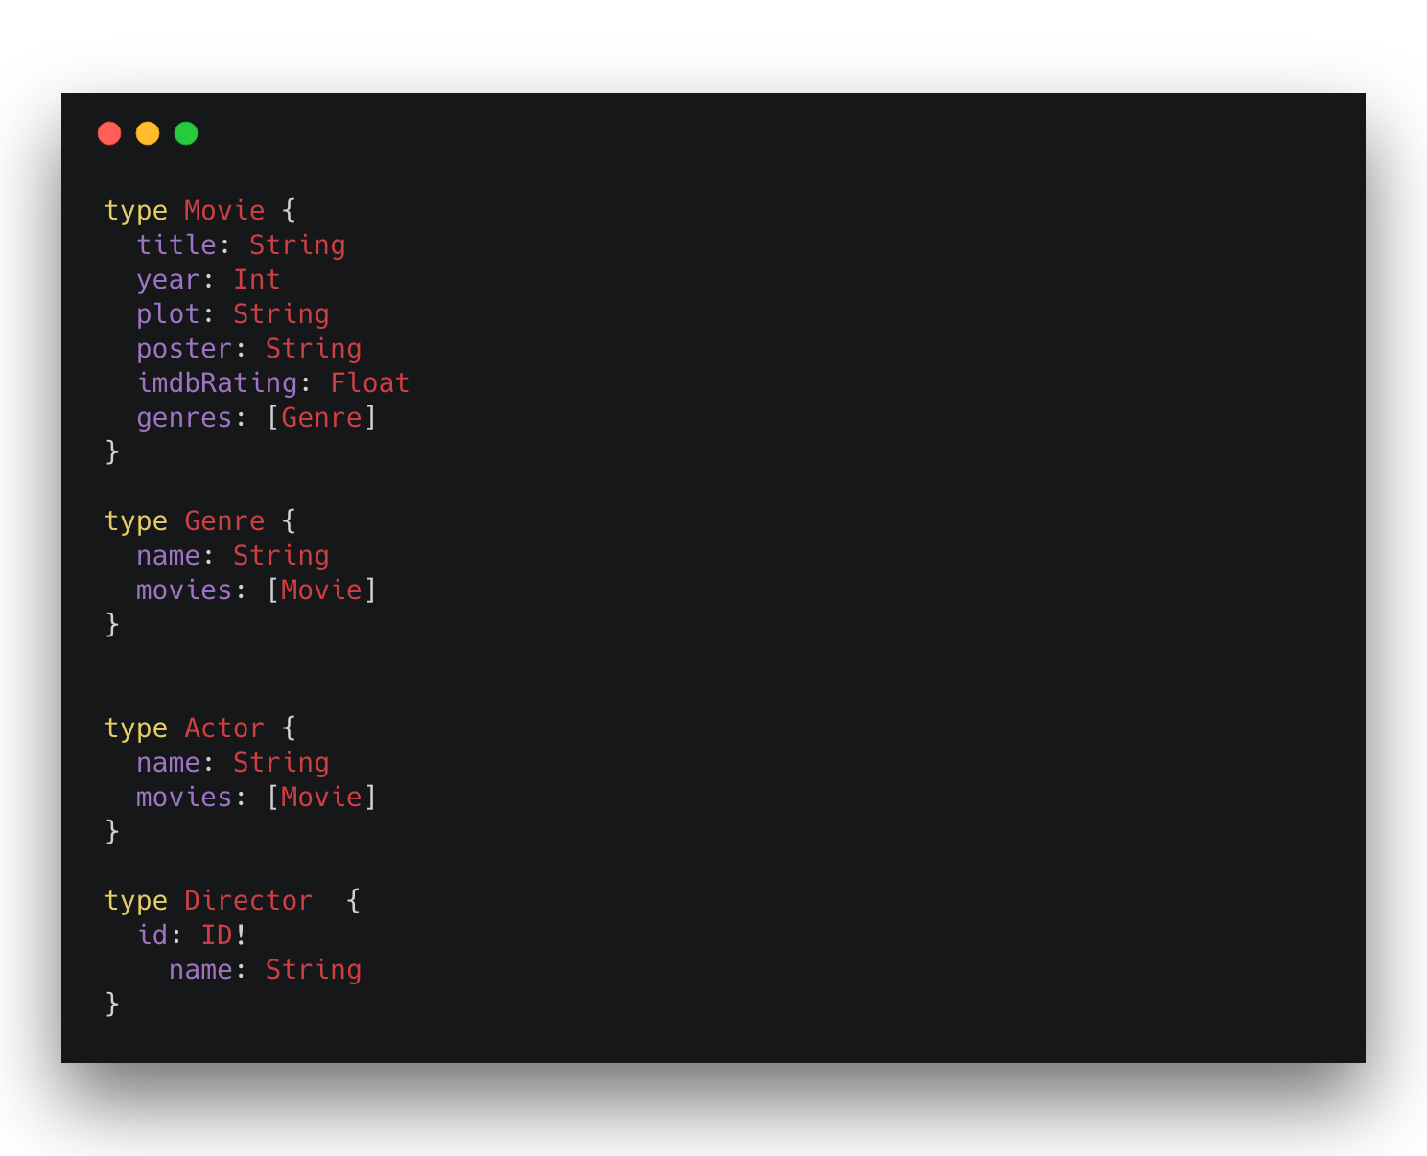
Movies, Genres, Directors, Actors
GraphQL Type Definitions
Defined using GraphQL Schema Definition Language (SDL)
@lyonwj
Notes:
MATCH (m:Movie) WHERE m.title CONTAINS "River Runs Through It"
MATCH (m)-[:IN_GENRE]->(g:Genre)
MATCH (m)<-[:DIRECTED]-(d:Director)-[:DIRECTED]->(o:Movie)
MATCH (m)<-[:ACTED_IN]-(a:Actor)
MATCH (o)-[:IN_GENRE]->(go:Genre)
RETURN *
{
Movie(title: "River Runs Through It, A") {
title
actedIn(first: 2) {
name
}
inGenre {
name
}
directed {
name
directed(first: 3) {
title
}
}
}
}

Slide 19
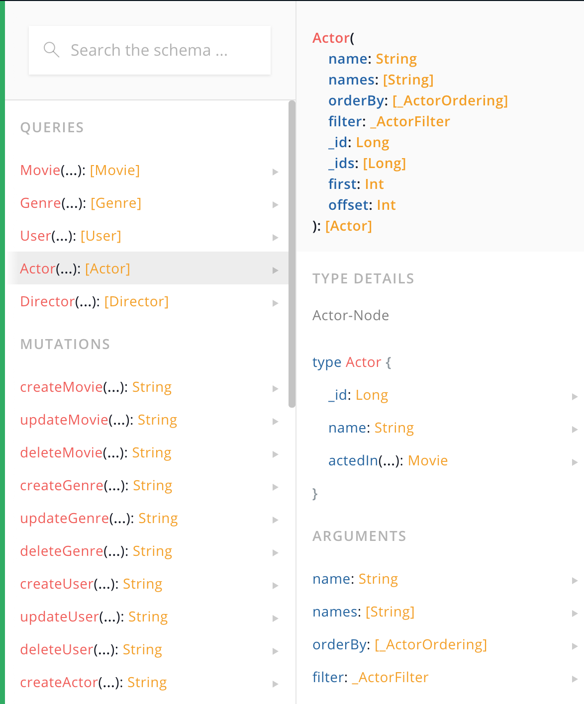
Movies, Genres, Directors, Actors
Introspection
Schema can be queried
Schema becomes API specification / documentation
Tools like GraphiQL / GraphQL Playground
@lyonwj
Notes:
MATCH (m:Movie) WHERE m.title CONTAINS "River Runs Through It"
MATCH (m)-[:IN_GENRE]->(g:Genre)
MATCH (m)<-[:DIRECTED]-(d:Director)-[:DIRECTED]->(o:Movie)
MATCH (m)<-[:ACTED_IN]-(a:Actor)
MATCH (o)-[:IN_GENRE]->(go:Genre)
RETURN *
{
Movie(title: "River Runs Through It, A") {
title
actedIn(first: 2) {
name
}
inGenre {
name
}
directed {
name
directed(first: 3) {
title
}
}
}
}

Slide 20
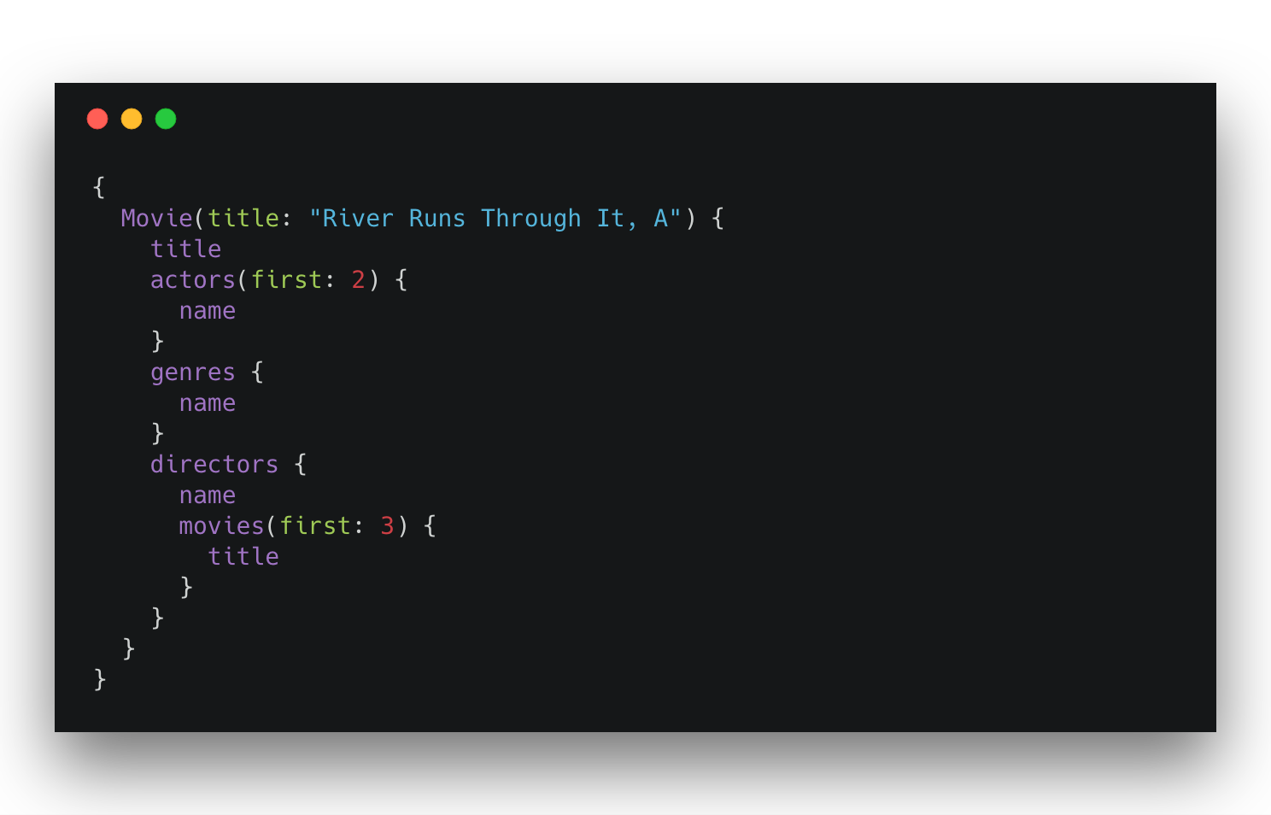
Movies, Genres, Directors, Actors
GraphQL query
@lyonwj
Notes:
MATCH (m:Movie) WHERE m.title CONTAINS "River Runs Through It"
MATCH (m)-[:IN_GENRE]->(g:Genre)
MATCH (m)<-[:DIRECTED]-(d:Director)-[:DIRECTED]->(o:Movie)
MATCH (m)<-[:ACTED_IN]-(a:Actor)
MATCH (o)-[:IN_GENRE]->(go:Genre)
RETURN *
{
Movie(title: "River Runs Through It, A") {
title
actedIn(first: 2) {
name
}
inGenre {
name
}
directed {
name
directed(first: 3) {
title
}
}
}
}

Slide 21
Operation name and arguments
@lyonwj
https://blog.apollographql.com/the-anatomy-of-a-graphql-query-6dffa9e9e747
Notes:
MATCH (m:Movie) WHERE m.title CONTAINS "River Runs Through It"
MATCH (m)-[:IN_GENRE]->(g:Genre)
MATCH (m)<-[:DIRECTED]-(d:Director)-[:DIRECTED]->(o:Movie)
MATCH (m)<-[:ACTED_IN]-(a:Actor)
MATCH (o)-[:IN_GENRE]->(go:Genre)
RETURN *
{
Movie(title: "River Runs Through It, A") {
title
actedIn(first: 2) {
name
}
inGenre {
name
}
directed {
name
directed(first: 3) {
title
}
}
}
}

Slide 22
Selection set
@lyonwj
https://blog.apollographql.com/the-anatomy-of-a-graphql-query-6dffa9e9e747
Notes:
MATCH (m:Movie) WHERE m.title CONTAINS "River Runs Through It"
MATCH (m)-[:IN_GENRE]->(g:Genre)
MATCH (m)<-[:DIRECTED]-(d:Director)-[:DIRECTED]->(o:Movie)
MATCH (m)<-[:ACTED_IN]-(a:Actor)
MATCH (o)-[:IN_GENRE]->(go:Genre)
RETURN *
{
Movie(title: "River Runs Through It, A") {
title
actedIn(first: 2) {
name
}
inGenre {
name
}
directed {
name
directed(first: 3) {
title
}
}
}
}

Slide 23
Movies, Genres, Directors, Actors
GraphQL query
@lyonwj
Notes:
MATCH (m:Movie) WHERE m.title CONTAINS "River Runs Through It"
MATCH (m)-[:IN_GENRE]->(g:Genre)
MATCH (m)<-[:DIRECTED]-(d:Director)-[:DIRECTED]->(o:Movie)
MATCH (m)<-[:ACTED_IN]-(a:Actor)
MATCH (o)-[:IN_GENRE]->(go:Genre)
RETURN *
{
Movie(title: "River Runs Through It, A") {
title
actedIn(first: 2) {
name
}
inGenre {
name
}
directed {
name
directed(first: 3) {
title
}
}
}
}

Slide 24
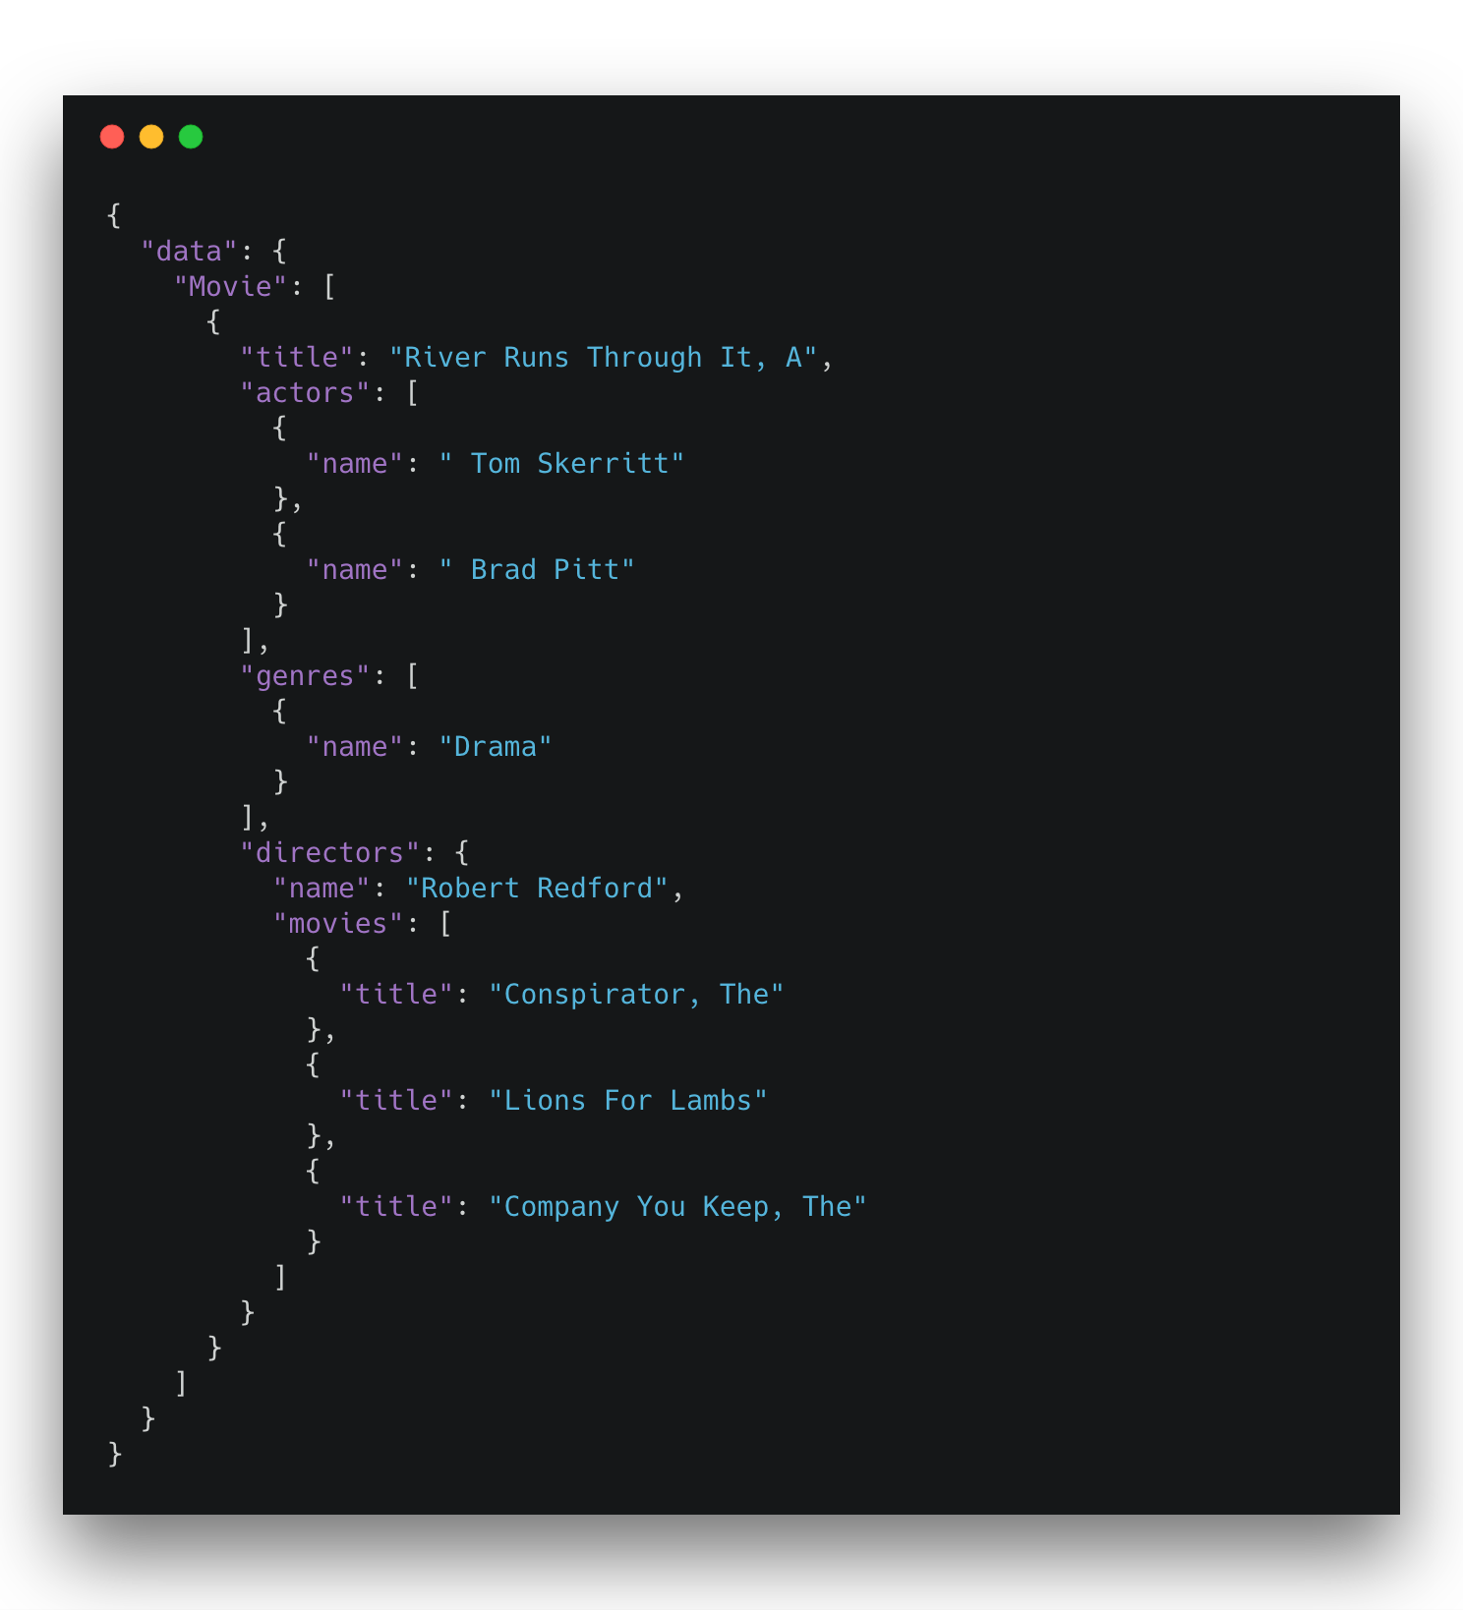
Movies, Genres, Directors, Actors
GraphQL query
@lyonwj
GraphQL response
Notes:
{
"data": {
"Movie": [
{
"title": "River Runs Through It, A",
"actedIn": [
{
"name": " Tom Skerritt"
},
{
"name": " Brad Pitt"
}
],
"inGenre": [
{
"name": "Drama"
}
],
"directed": {
"name": "Robert Redford",
"directed": [
{
"title": "Conspirator, The"
},
{
"title": "Lions For Lambs"
},
{
"title": "Company You Keep, The"
}
]
}
}
]
},
"extensions": {
"type": "READ_ONLY"
}
}

Slide 25
What is GraphQL?
GraphQL is an API query language, not a database query language.
Limited expressivity (no projections, no aggregations, etc).
While GraphQL exposes your application data as a graph, it’s not (just) for graph databases
@lyonwj

Slide 26


GraphQL Advantages
Overfetching
Less data over the wire
Underfetching
Single round trip
GraphQL Specification
“Graphs All The Way Down”
Relationships vs Resources
Unify disparate systems (microservices)
Simplify data fetching
Component based data interactions
@lyonwj

Slide 27

GraphQL Challenges
Some well understood practices from REST don’t apply
HTTP status codes
Errors
Caching
Exposing arbitrary complexity to client
Performance considerations
n+1 query problem
Query costing / rate limiting
@lyonwj

Slide 28
Example API & How It’s Built

Slide 29
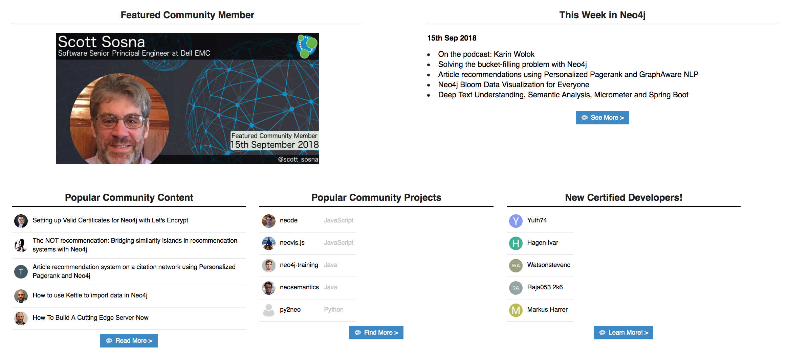
Example GraphQL API
Neo4j Community Forum Trending Activity Feeds
@lyonwj
community.neo4j.com

Slide 30
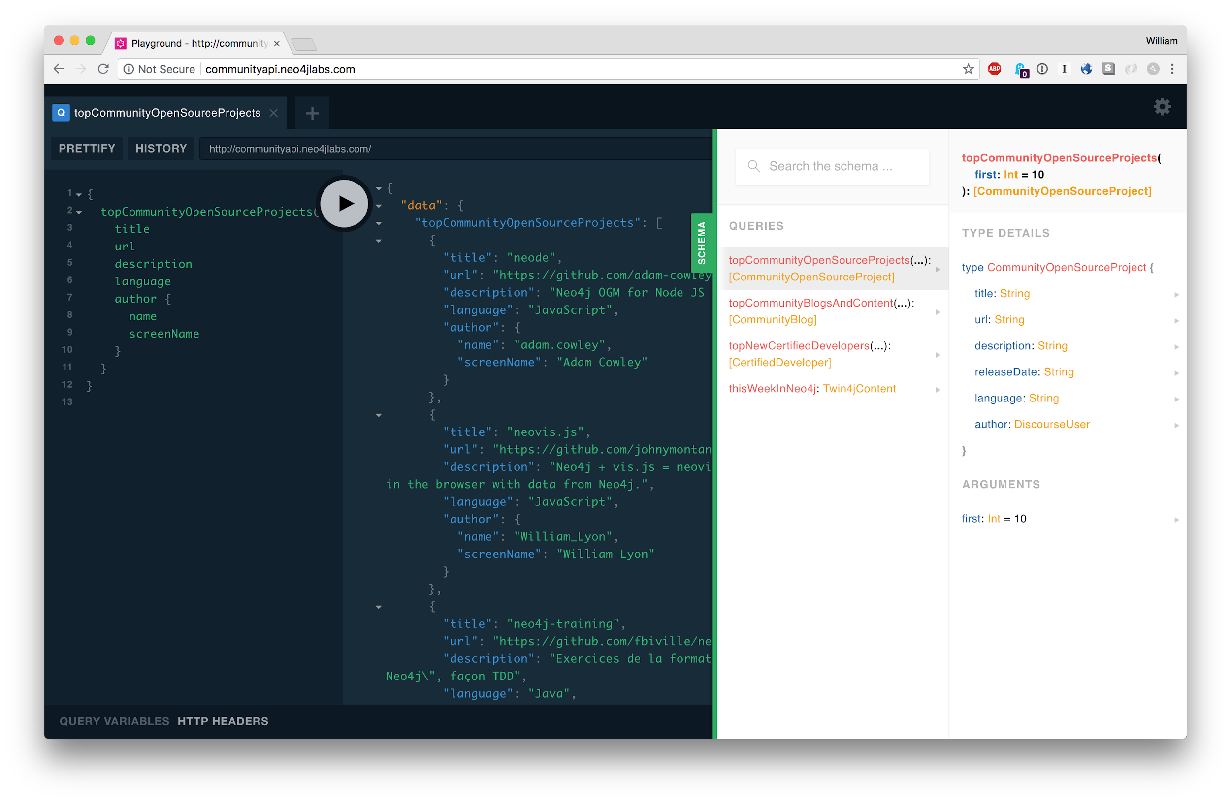
communityapi.neo4jlabs.com
@lyonwj
Notes:
{
topCommunityOpenSourceProjects(first: 5) {
title
url
description
language
author {
name
screenName
}
}
}

Slide 31
How To Build A GraphQL Service
Notes:
use Carbon for all code examples

Slide 32
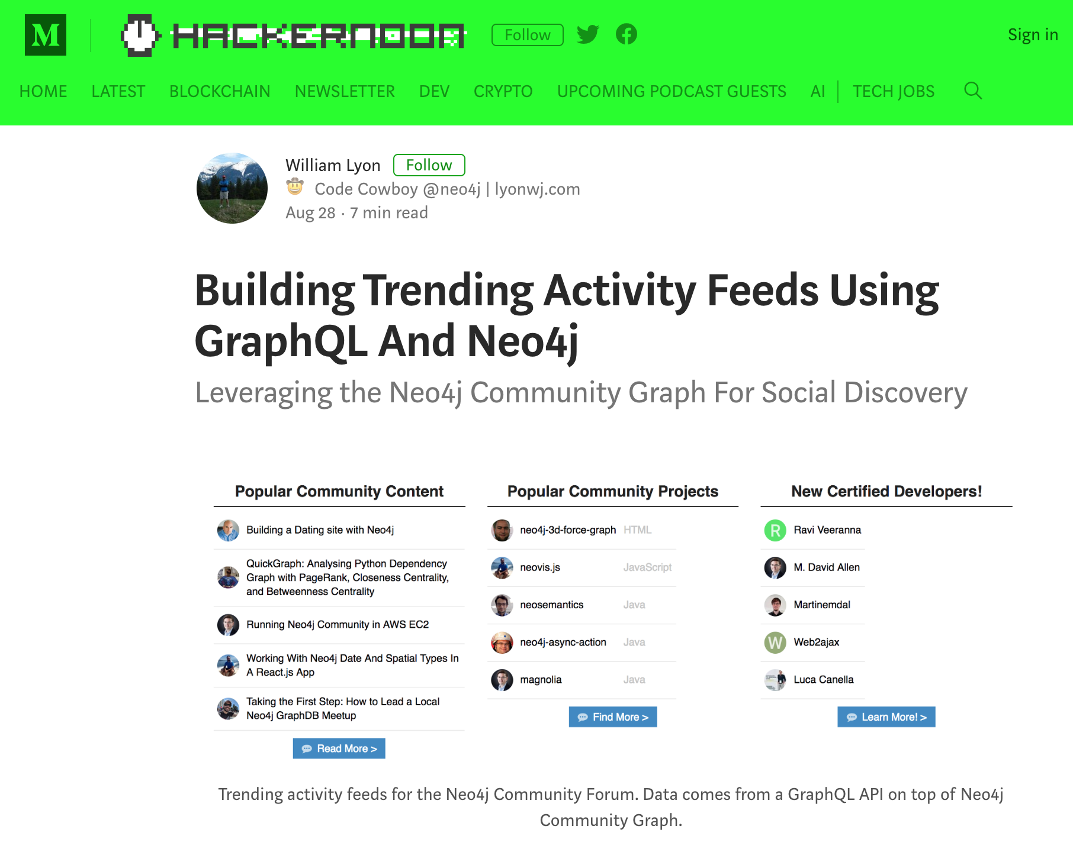
@lyonwj
hackernoon.com/building-trending-activity-feeds-using-graphql-and-neo4j-e62ee790238e

Slide 33
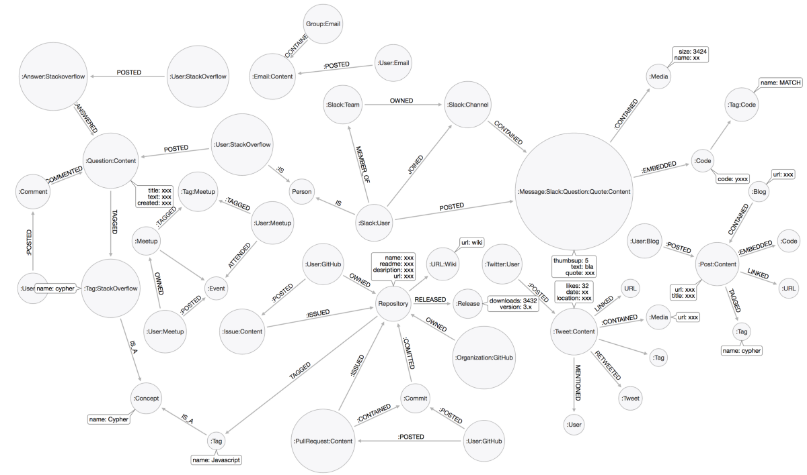
Community Graph
http://138.197.15.1:7474/browser/
user: community
password: community
@lyonwj

Slide 34
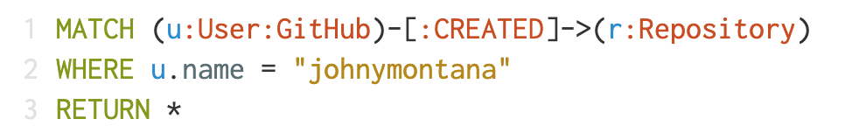
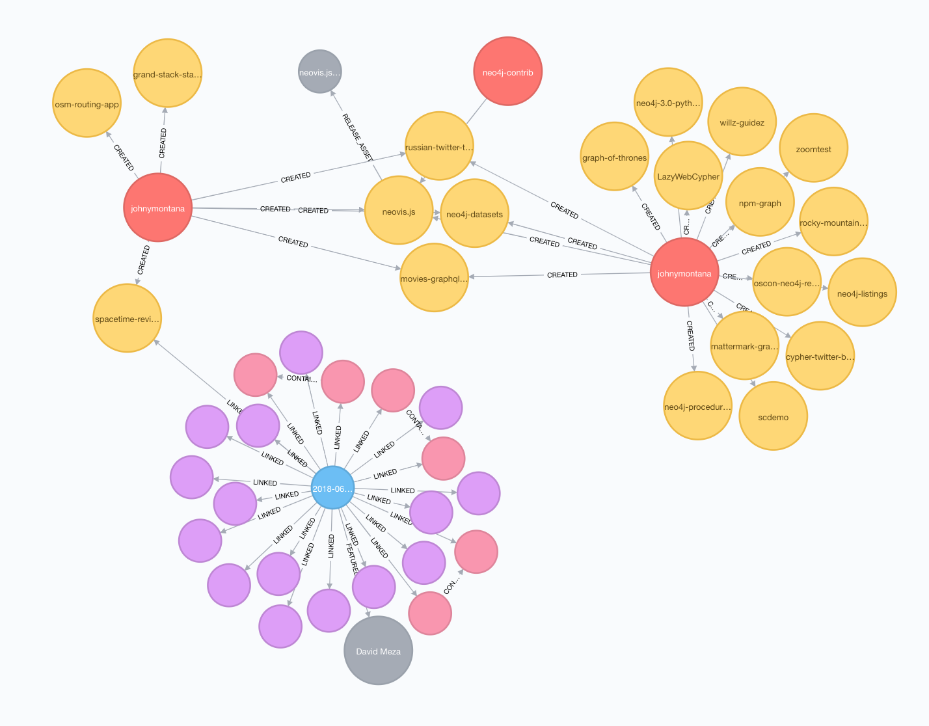
@lyonwj

Slide 35
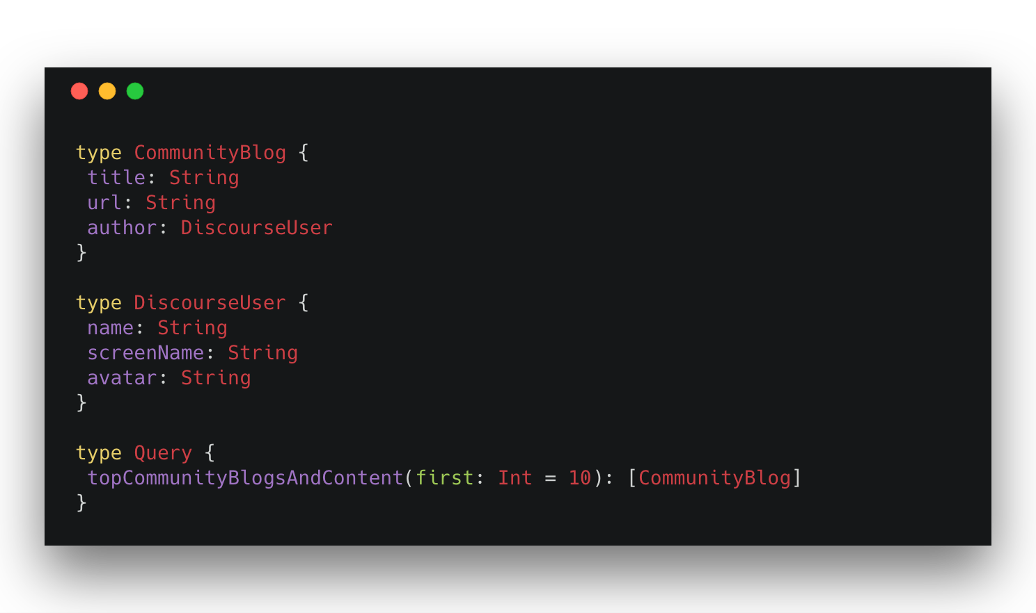
Start With A GraphQL Schema
@lyonwj
graphql.org/learn/schema/#type-language
Notes:
type CommunityBlog {
title: String
url: String
author: DiscourseUser
}
type DiscourseUser {
name: String
screenName: String
avatar: String
}
type Query {
topCommunityBlogsAndContent(first: Int = 10): [CommunityBlog]
}

Slide 36
Start With A GraphQL Schema
Type Definitions
@lyonwj
Notes:
type CommunityBlog {
title: String
url: String
author: DiscourseUser
}
type DiscourseUser {
name: String
screenName: String
avatar: String
}
type Query {
topCommunityBlogsAndContent(first: Int = 10): [CommunityBlog]
}

Slide 37
Start With A GraphQL Schema
API Entry Point(s)
Query & Mutation Types
@lyonwj
Notes:
type CommunityBlog {
title: String
url: String
author: DiscourseUser
}
type DiscourseUser {
name: String
screenName: String
avatar: String
}
type Query {
topCommunityBlogsAndContent(first: Int = 10): [CommunityBlog]
}

Slide 38
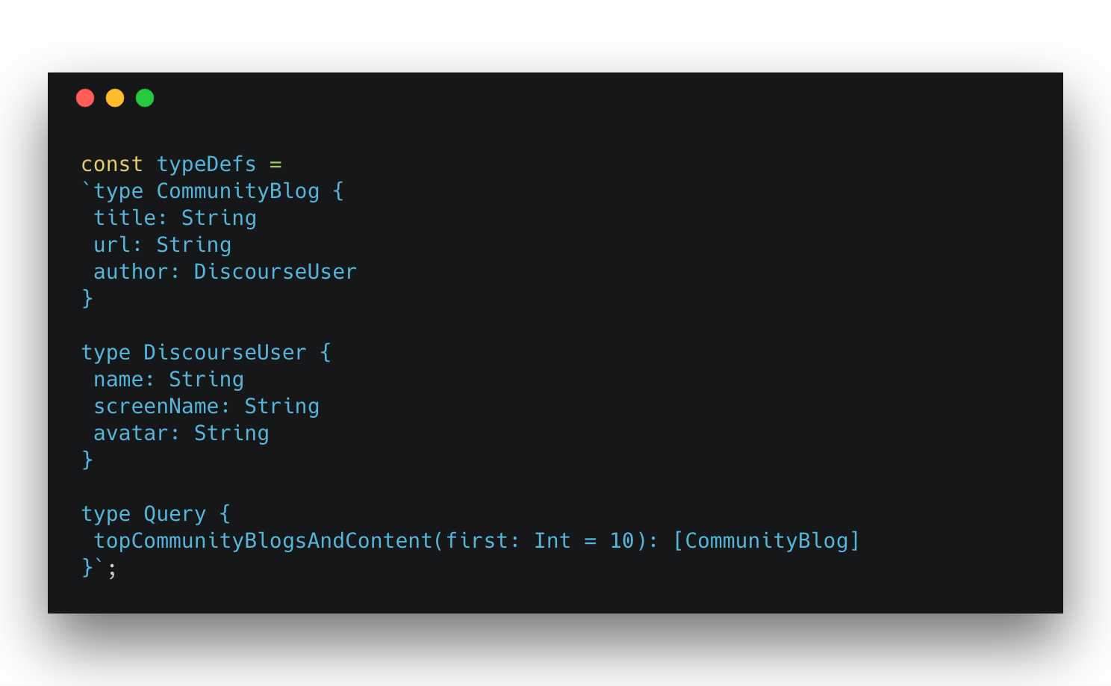
Start With A GraphQL Schema
API Entry Point(s)
Query & Mutation Types
@lyonwj
graphql.org/learn/schema/#type-language
Notes:
const typeDefs =
`type CommunityBlog {
title: String
url: String
author: DiscourseUser
}
type DiscourseUser {
name: String
screenName: String
avatar: String
}
type Query {
topCommunityBlogsAndContent(first: Int = 10): [CommunityBlog]
}`;

Slide 39
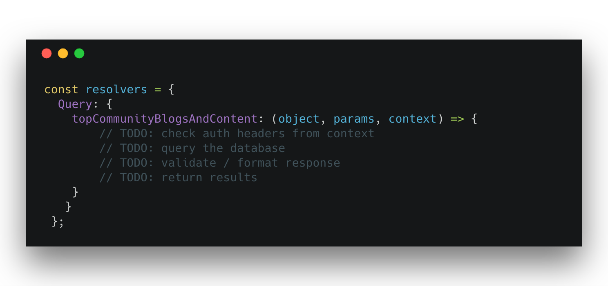
GraphQL Resolvers
Functions that define how to “resolve” data for GraphQL request
@lyonwj
graphql.org/learn/execution/#root-fields-resolvers
Notes:
const resolvers = {
Query: {
topCommunityBlogsAndContent: (object, params, context) => {
// TODO: check auth headers from context
// TODO: query the database
// TODO: validate / format response
// TODO: return results
}
}
};

Slide 40
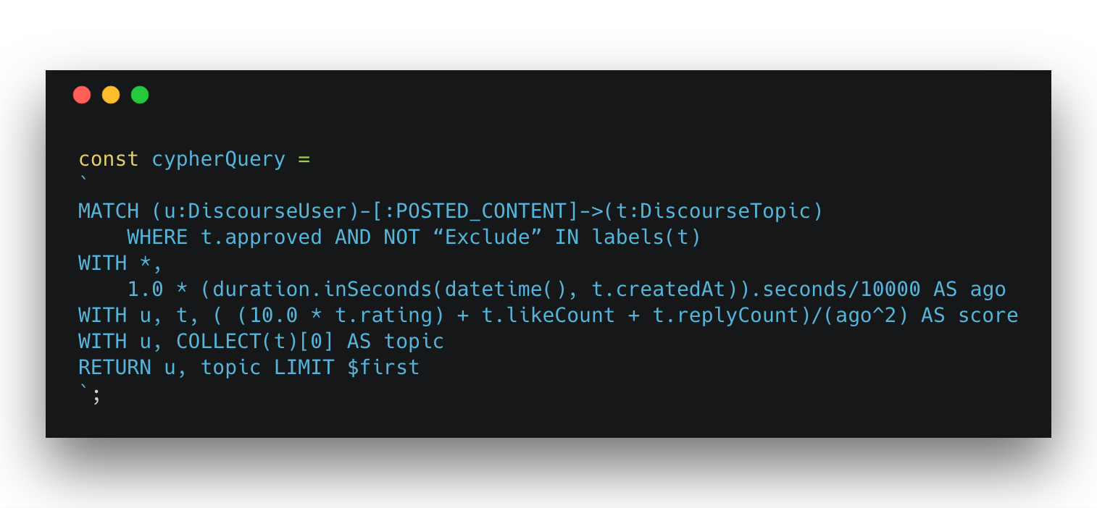
Cypher Query
https://hackernoon.com/building-trending-activity-feeds-using-graphql-and-neo4j-e62ee790238e
@lyonwj
Notes:
const cypherQuery =
`
MATCH (u:DiscourseUser)-[:POSTED_CONTENT]->(t:DiscourseTopic)
WHERE t.approved AND NOT “Exclude” IN labels(t)
WITH *,
1.0 * (duration.inSeconds(datetime(), t.createdAt)).seconds/10000 AS ago
WITH u, t, ( (10.0 * t.rating) + t.likeCount + t.replyCount)/(ago^2) AS score
WITH u, COLLECT(t)[0] AS topic
RETURN u, topic LIMIT $first
`;

Slide 41
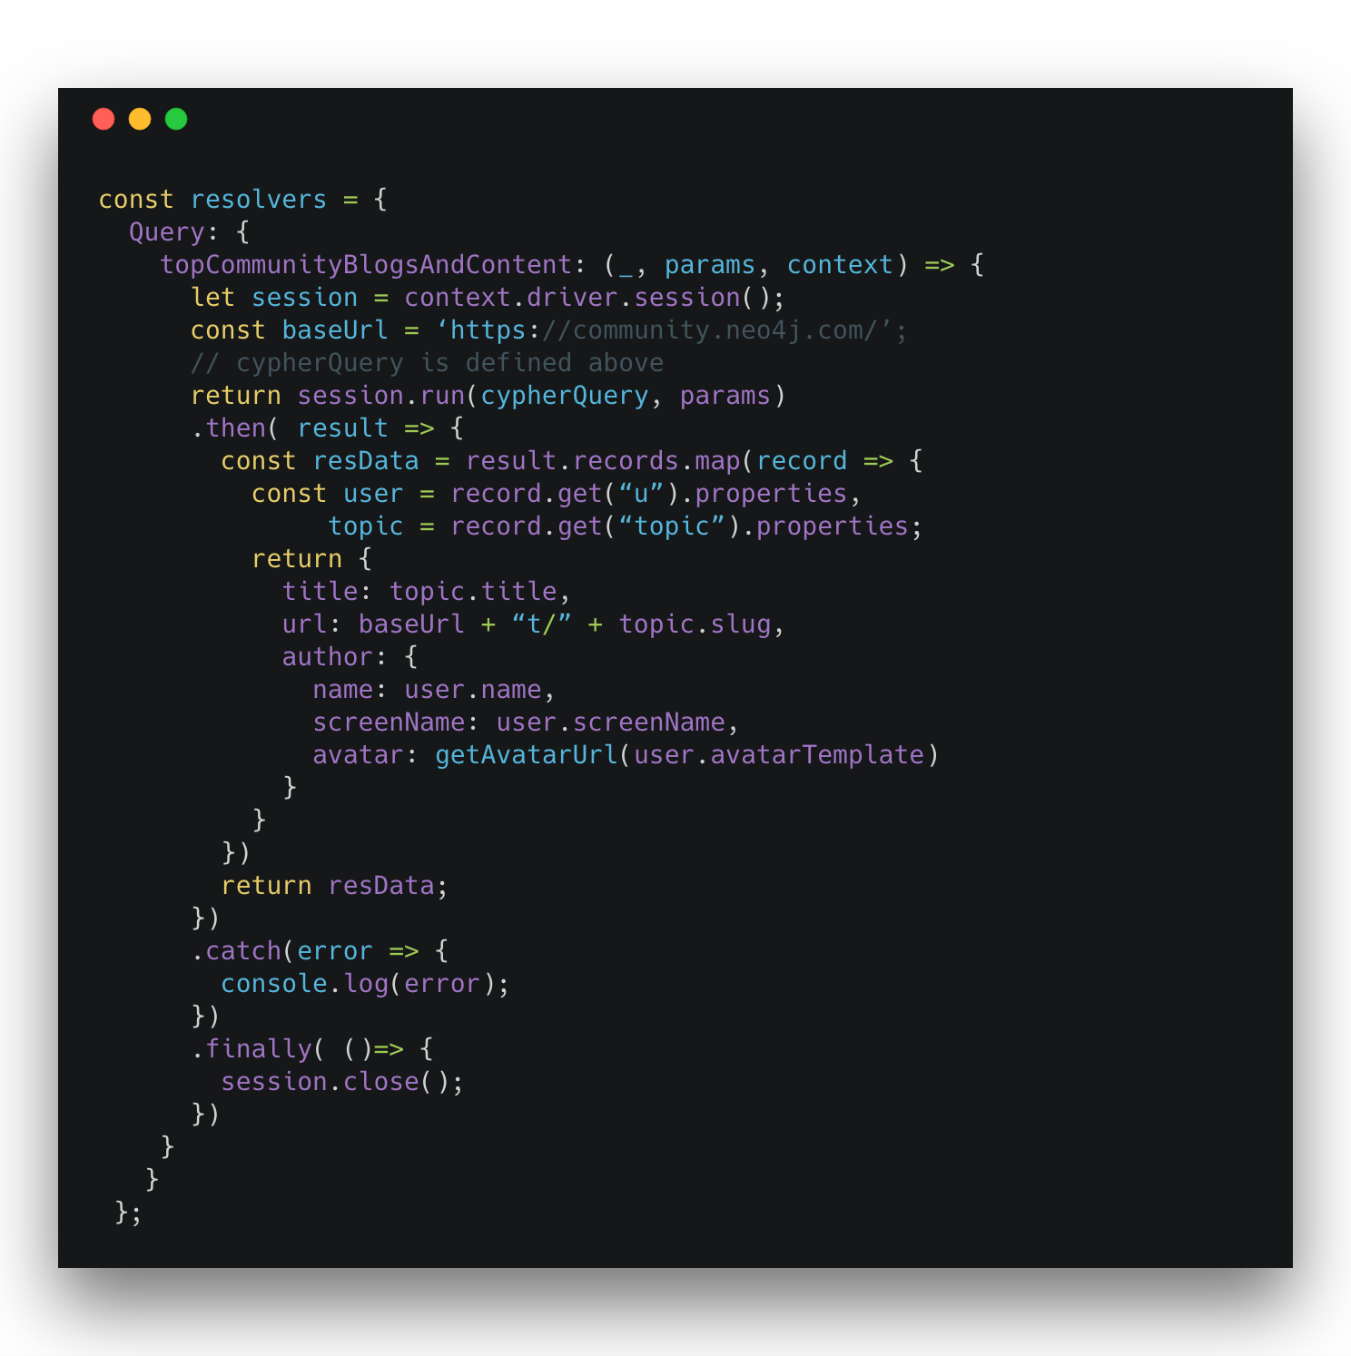
Resolvers
@lyonwj
Notes:
const resolvers = {
Query: {
topCommunityBlogsAndContent: (_, params, context) => {
let session = context.driver.session();
const baseUrl = ‘https://community.neo4j.com/’;
// cypherQuery is defined above
return session.run(cypherQuery, params)
.then( result => {
const resData = result.records.map(record => {
const user = record.get(“u”).properties,
topic = record.get(“topic”).properties;
return {
title: topic.title,
url: baseUrl + “t/” + topic.slug,
author: {
name: user.name,
screenName: user.screenName,
avatar: getAvatarUrl(user.avatarTemplate)
}
}
})
return resData;
})
.catch(error => {
console.log(error);
})
.finally( ()=> {
session.close();
})
}
}
};

Slide 42
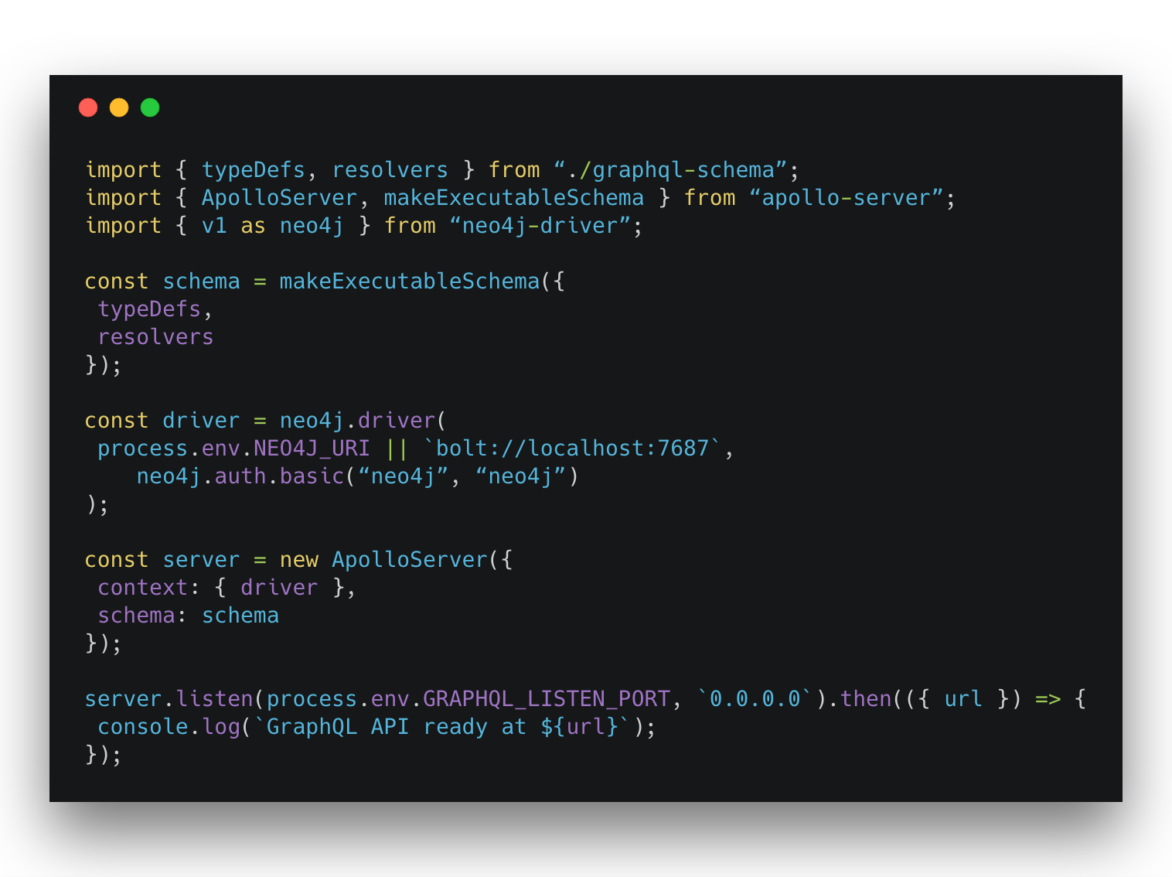
Apollo Server
@lyonwj
https://www.apollographql.com/docs/apollo-server/
Notes:
import { typeDefs, resolvers } from “./graphql-schema”;
import { ApolloServer, makeExecutableSchema } from “apollo-server”;
import { v1 as neo4j } from “neo4j-driver”;
const schema = makeExecutableSchema({
typeDefs,
resolvers
});
const driver = neo4j.driver(
process.env.NEO4J_URI || `bolt://localhost:7687`,
neo4j.auth.basic(“neo4j”, “neo4j”)
);
const server = new ApolloServer({
context: { driver },
schema: schema
});
server.listen(process.env.GRAPHQL_LISTEN_PORT, `0.0.0.0`).then(({ url }) => {
console.log(`GraphQL API ready at ${url}`);
});

Slide 43
Apollo Server
@lyonwj
Notes:
import { typeDefs, resolvers } from “./graphql-schema”;
import { ApolloServer, makeExecutableSchema } from “apollo-server”;
import { v1 as neo4j } from “neo4j-driver”;
const schema = makeExecutableSchema({
typeDefs,
resolvers
});
const driver = neo4j.driver(
process.env.NEO4J_URI || `bolt://localhost:7687`,
neo4j.auth.basic(“neo4j”, “neo4j”)
);
const server = new ApolloServer({
context: { driver },
schema: schema
});
server.listen(process.env.GRAPHQL_LISTEN_PORT, `0.0.0.0`).then(({ url }) => {
console.log(`GraphQL API ready at ${url}`);
});

Slide 44
Apollo Server
@lyonwj
Notes:
import { typeDefs, resolvers } from “./graphql-schema”;
import { ApolloServer, makeExecutableSchema } from “apollo-server”;
import { v1 as neo4j } from “neo4j-driver”;
const schema = makeExecutableSchema({
typeDefs,
resolvers
});
const driver = neo4j.driver(
process.env.NEO4J_URI || `bolt://localhost:7687`,
neo4j.auth.basic(“neo4j”, “neo4j”)
);
const server = new ApolloServer({
context: { driver },
schema: schema
});
server.listen(process.env.GRAPHQL_LISTEN_PORT, `0.0.0.0`).then(({ url }) => {
console.log(`GraphQL API ready at ${url}`);
});

Slide 45
Apollo Server
@lyonwj
Notes:
import { typeDefs, resolvers } from “./graphql-schema”;
import { ApolloServer, makeExecutableSchema } from “apollo-server”;
import { v1 as neo4j } from “neo4j-driver”;
const schema = makeExecutableSchema({
typeDefs,
resolvers
});
const driver = neo4j.driver(
process.env.NEO4J_URI || `bolt://localhost:7687`,
neo4j.auth.basic(“neo4j”, “neo4j”)
);
const server = new ApolloServer({
context: { driver },
schema: schema
});
server.listen(process.env.GRAPHQL_LISTEN_PORT, `0.0.0.0`).then(({ url }) => {
console.log(`GraphQL API ready at ${url}`);
});

Slide 46
Apollo Server
@lyonwj
Notes:
import { typeDefs, resolvers } from “./graphql-schema”;
import { ApolloServer, makeExecutableSchema } from “apollo-server”;
import { v1 as neo4j } from “neo4j-driver”;
const schema = makeExecutableSchema({
typeDefs,
resolvers
});
const driver = neo4j.driver(
process.env.NEO4J_URI || `bolt://localhost:7687`,
neo4j.auth.basic(“neo4j”, “neo4j”)
);
const server = new ApolloServer({
context: { driver },
schema: schema
});
server.listen(process.env.GRAPHQL_LISTEN_PORT, `0.0.0.0`).then(({ url }) => {
console.log(`GraphQL API ready at ${url}`);
});

Slide 47
communityapi.neo4jlabs.com
@lyonwj
Notes:
{
topCommunityOpenSourceProjects(first: 5) {
title
url
description
language
author {
name
screenName
}
}
}

Slide 48
Common Problems With This Approach
Schema Duplication
Mapping / translation layer from graph ←→ (???)
Boilerplate code
n+1 query problem
@lyonwj
https://blog.grandstack.io/five-common-graphql-problems-and-how-neo4j-graphql-aims-to-solve-them-e9a8999c8d43

Slide 49

GraphQL “Engines”

Slide 50



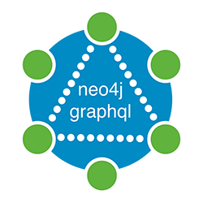


GraphQL “Engines” Overview
Tools for auto-generating GraphQL schema, generating database queries from GraphQL requests
Neo4j-GraphQL
prisma.io
aws.amazon.com/appsync
hasura.io
graphile.org
grandstack.io
@lyonwj

Slide 51
Neo4j-GraphQL

Slide 52
Goals for Neo4j-GraphQL Integration
GraphQL First Development
GraphQL schema drives the database data model
Generate Cypher from GraphQL
Single query / single round trip to database
Generate GraphQL CRUD API from type definitions
Auto-generated resolvers (no boilerplate!)
Extend GraphQL functionality with Cypher
@cypher schema directive
@lyonwj

Slide 53
GraphQL First Development
@lyonwj

Slide 54
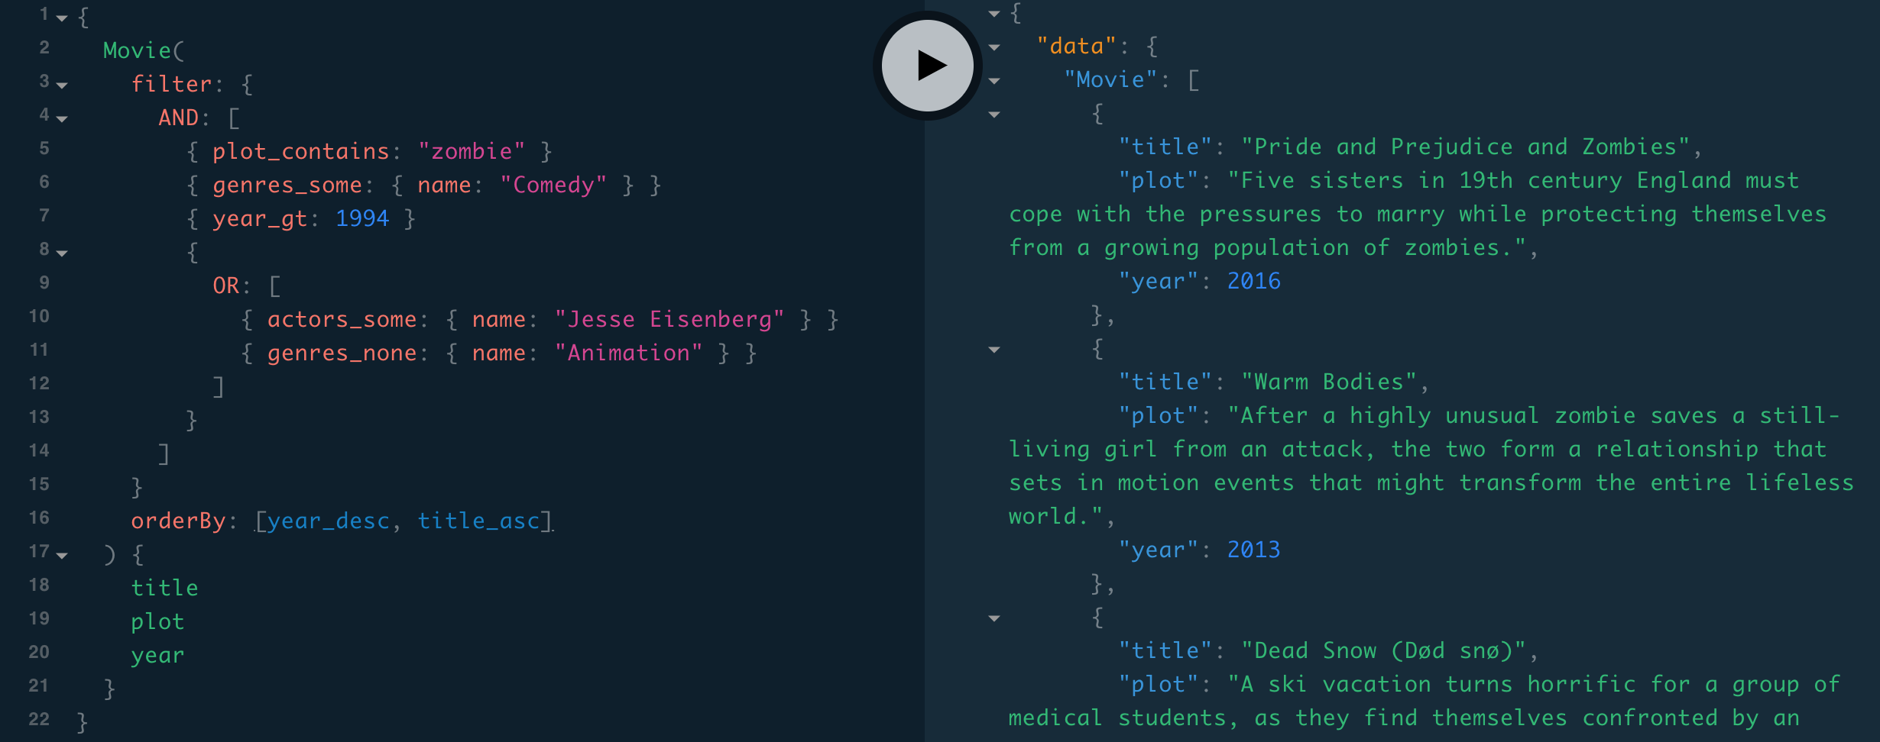
Auto-generate GraphQL CRUD API
Query & Mutation types
Entry point for each type
Ordering
Pagination
Complex Filter
DateTime types
@lyonwj
https://blog.grandstack.io/complex-graphql-filtering-with-neo4j-graphql-js-aef19ad06c3e

Slide 55
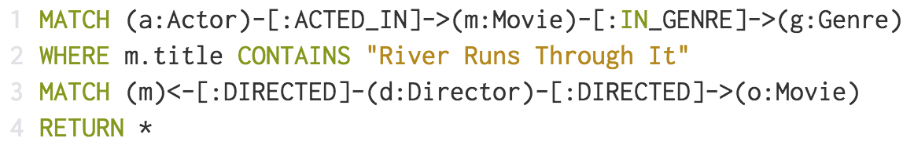
Generate Cypher From GraphQL
@lyonwj

Slide 56
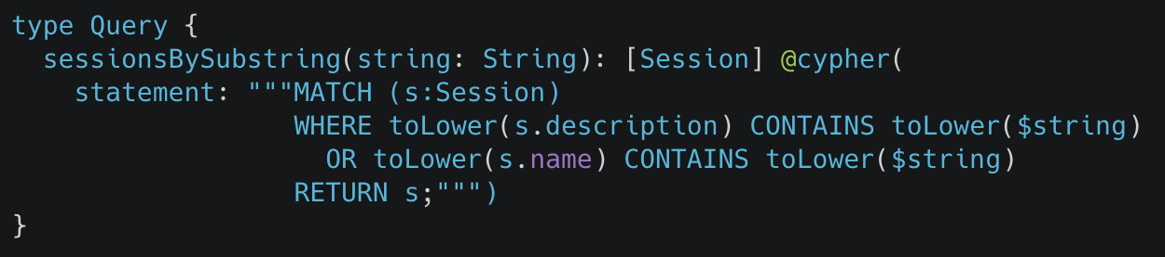
Extend GraphQL w/ Cypher
@cypher GraphQL schema directive
grandstack.io/docs/neo4j-graphql-js.html#cypher-directive
@lyonwj

Slide 57
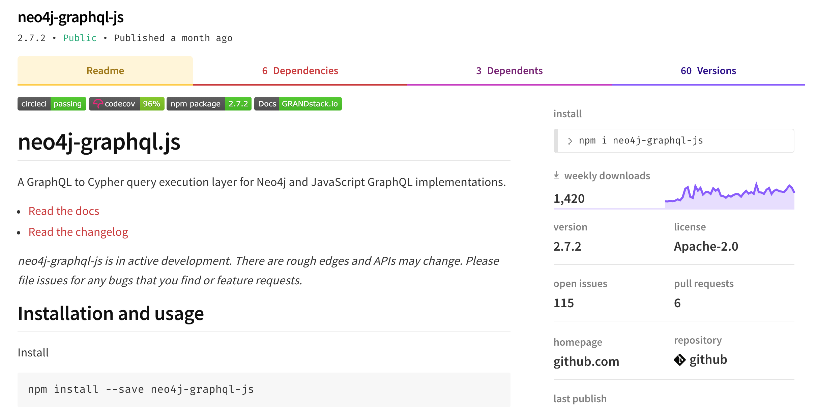
@lyonwj
www.npmjs.com/package/neo4j-graphql-js

Slide 58






neo4j-graphql-js
neo4j-graphql-js
apollo-server
@lyonwj

Slide 59
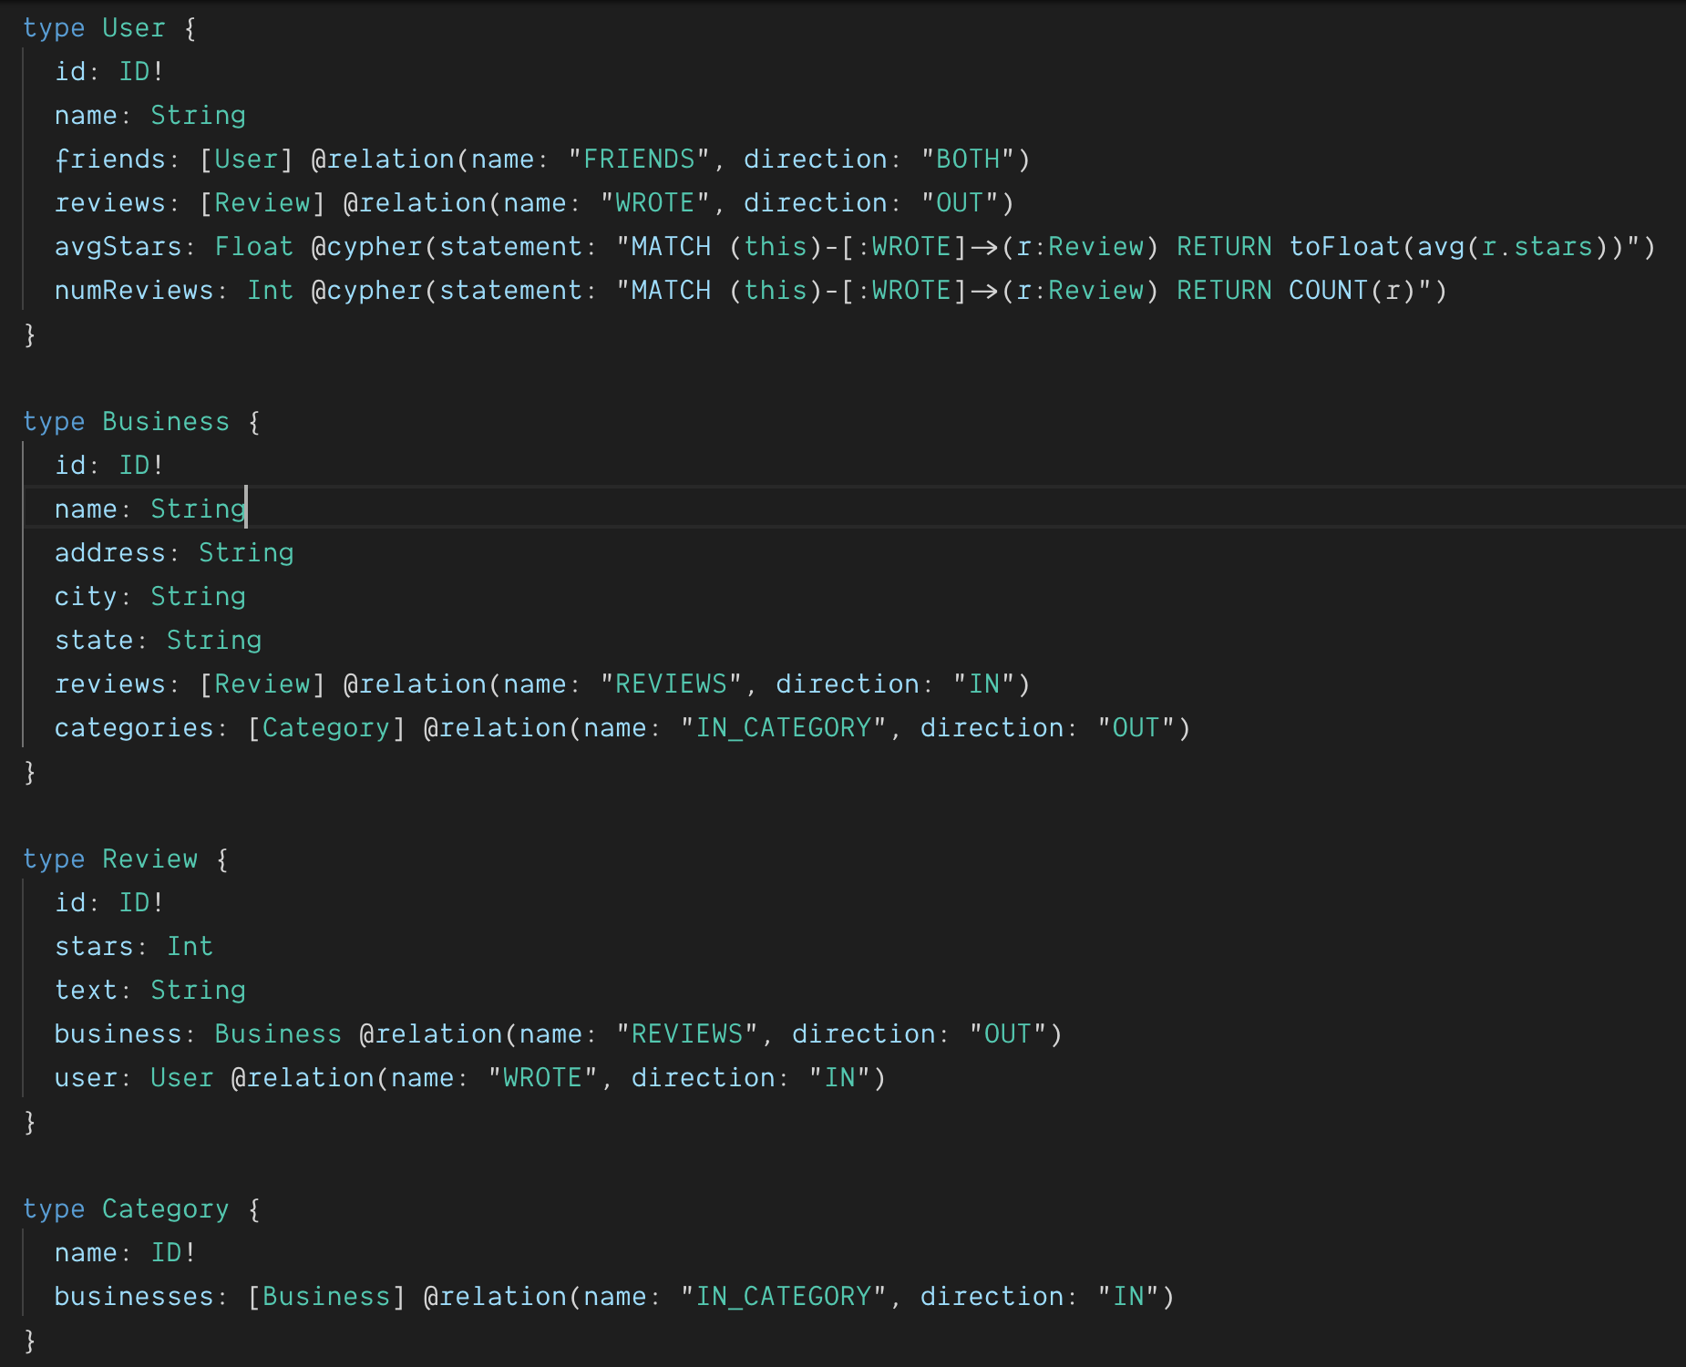
Demo
GRANDstack starter project
grandstack.io
@lyonwj
https://github.com/grand-stack/grand-stack-starter/tree/master/api/src

Slide 60
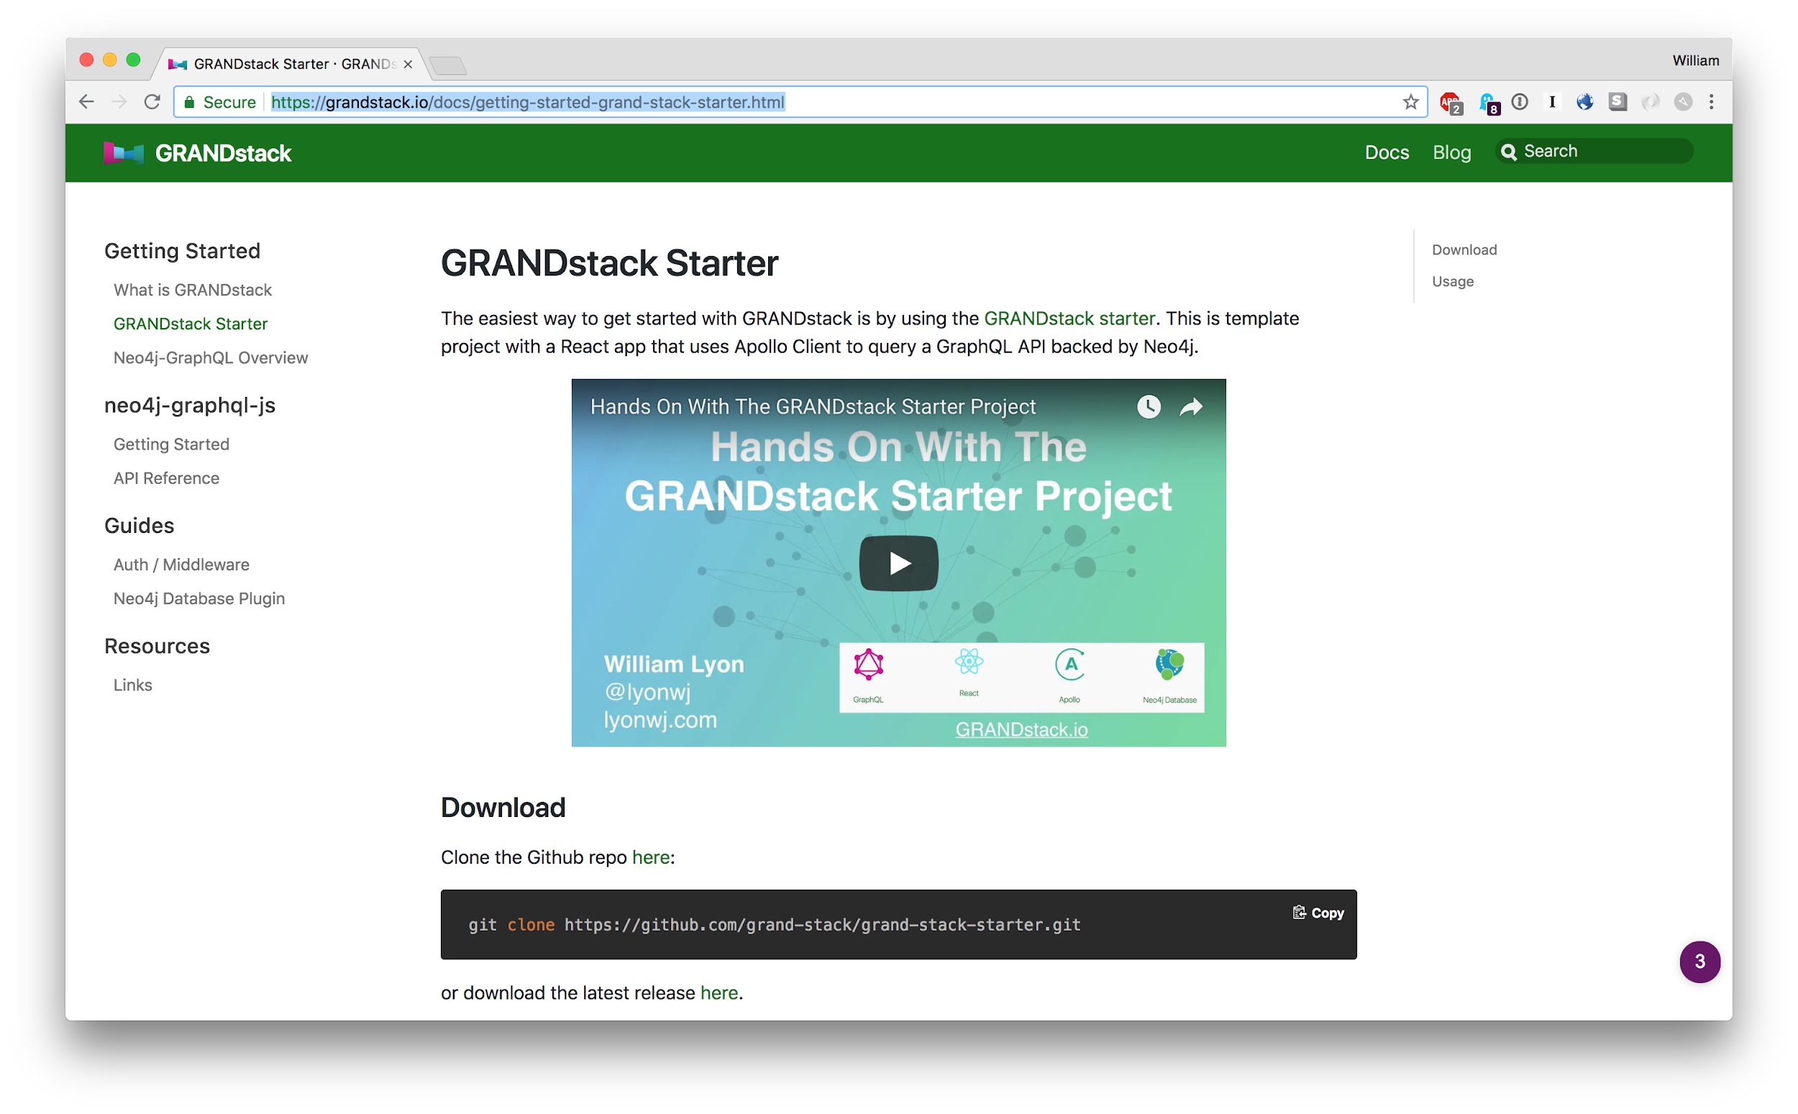
GRANDstack.io
@lyonwj

Slide 61
GraphQL ”Engines”
Declarative database integrations for GraphQL
GraphQL type definitions define database model
Provision CRUD GraphQL API
Auto-generated GraphQL API
Schema enrichments
Generate database queries
auto-generated resolvers
reduce boilerplate
@lyonwj

Slide 62
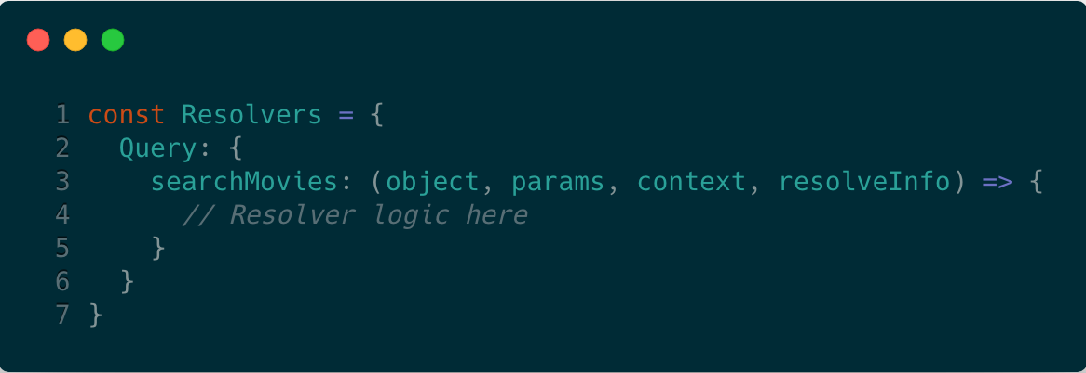
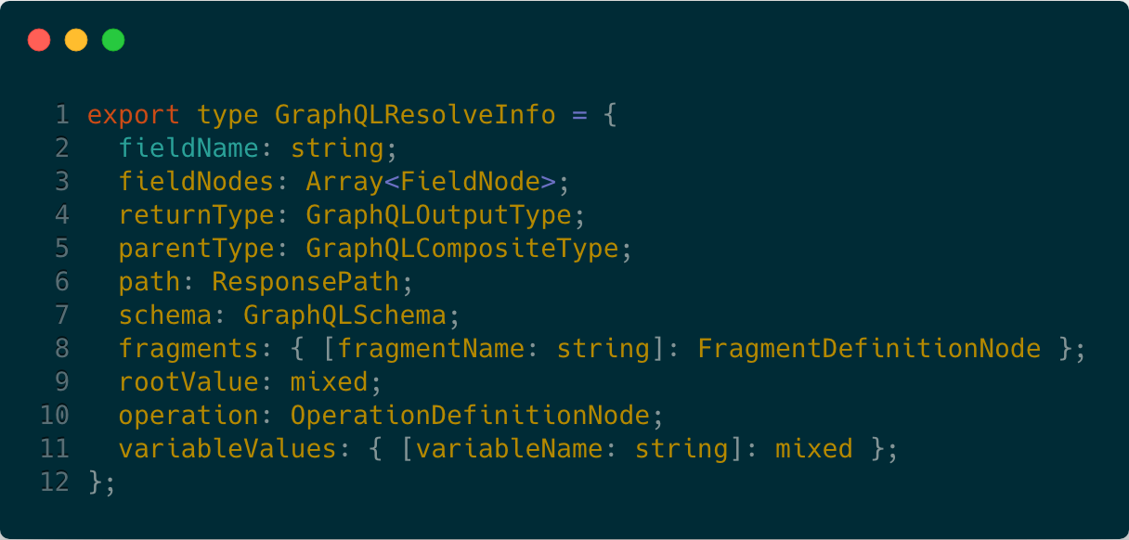
How Do GraphQL Engines Generate Database Queries From GraphQL Requests?
resolveInfo resolver argument
GraphQL query AST
GraphQL schema
Selection set
Variables
...
@lyonwj

Slide 63
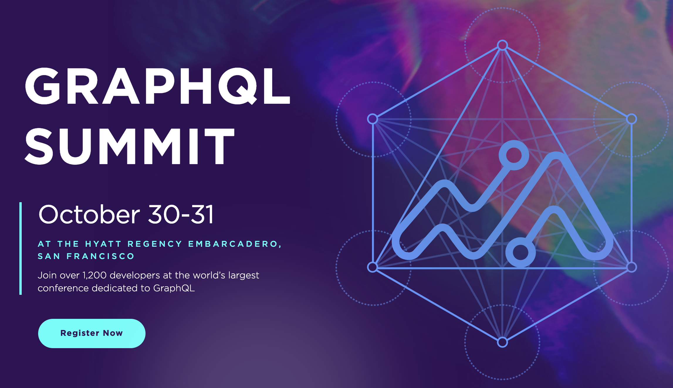
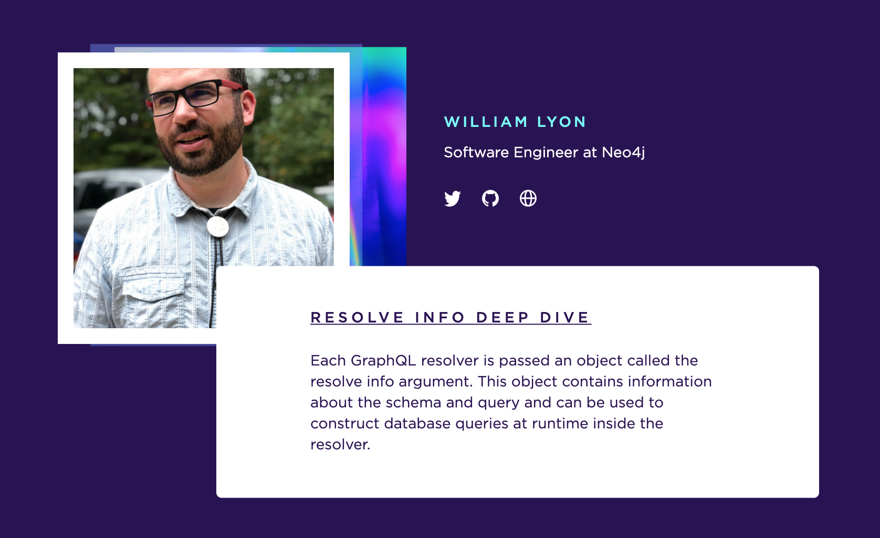
Use code “SPEAKERFRIEND”
for a 15% discount!!!
summit.graphql.com

Slide 64






REST In Practice - R.I.P.?

Slide 65

github.com/johnymontana/NODES2019-GRANDstack

Slide 66
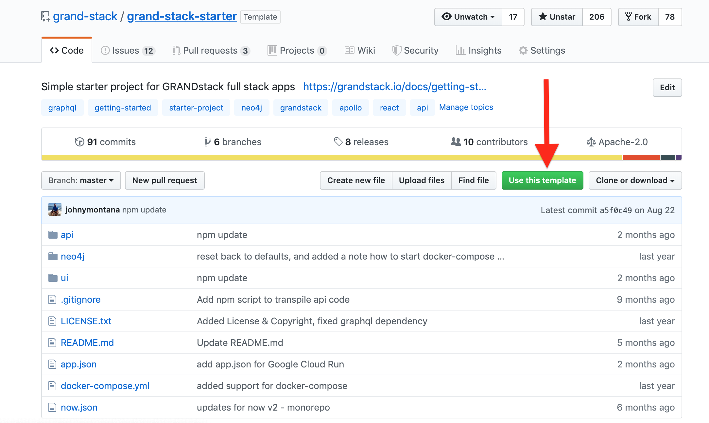
GRANDstack Starter Project
github.com/grand-stack/grand-stack-starter

Slide 67
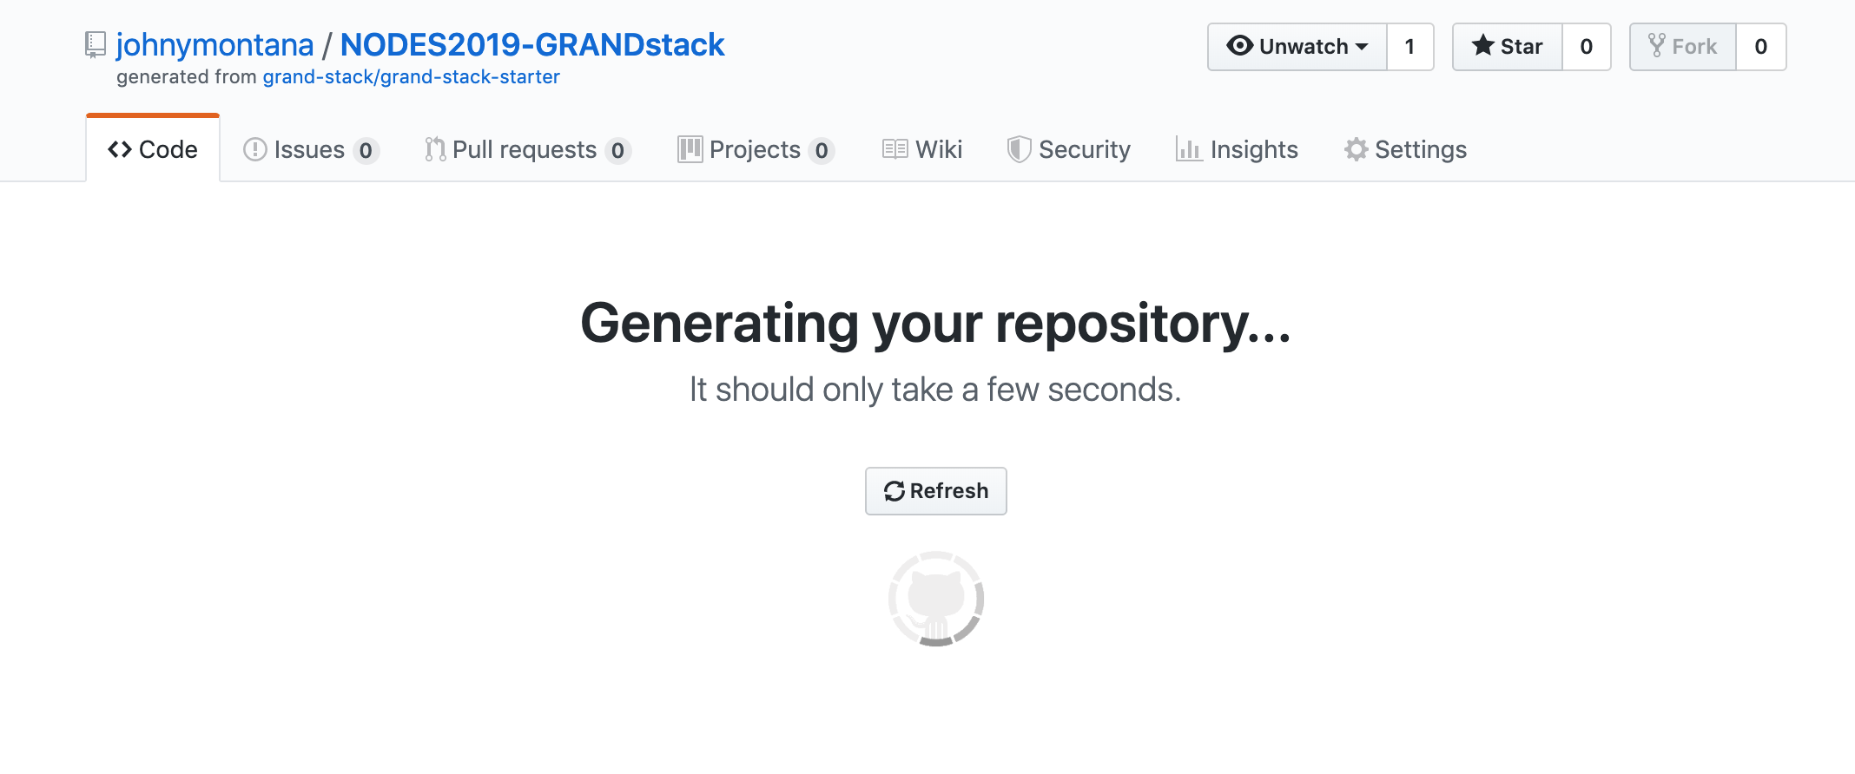
GRANDstack Starter Project
github.com/grand-stack/grand-stack-starter

Slide 68
GRANDstack Starter Project
github.com/grand-stack/grand-stack-starter

Slide 69
Domain Driven Design

Slide 70
Titled Columns Slide

Slide 71


Who’s using GRANDstack & Neo4j GraphQL?

Slide 72
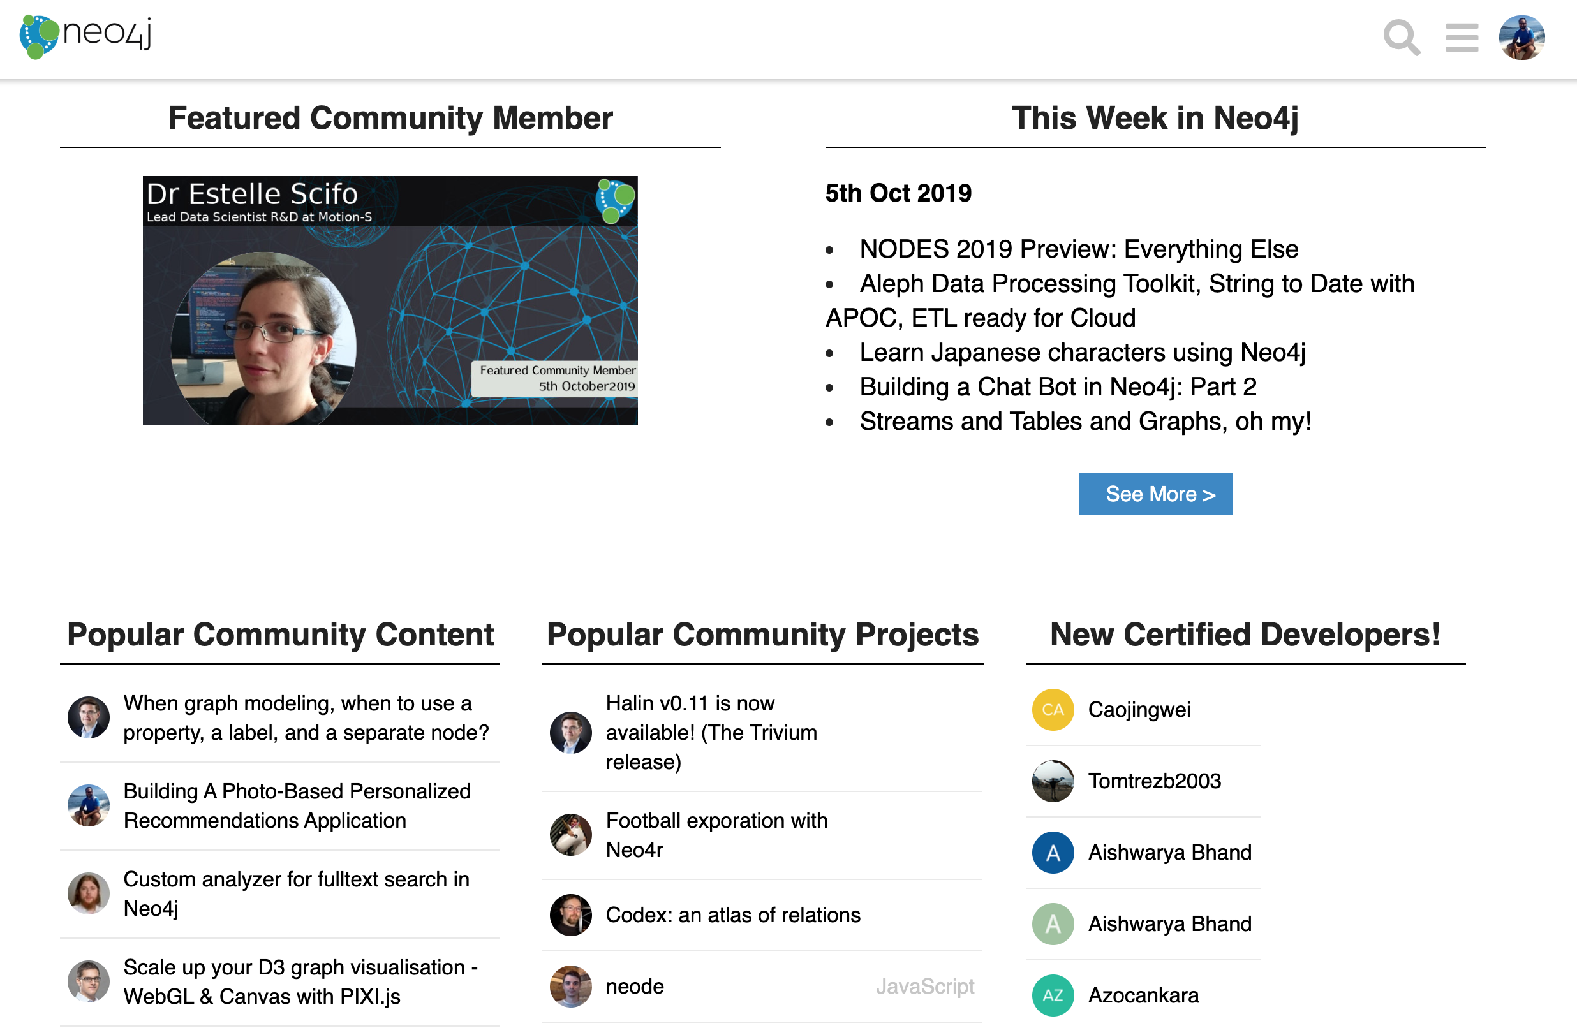
Who’s using GRANDstack & Neo4j GraphQL?
community.neo4j.com

Slide 73
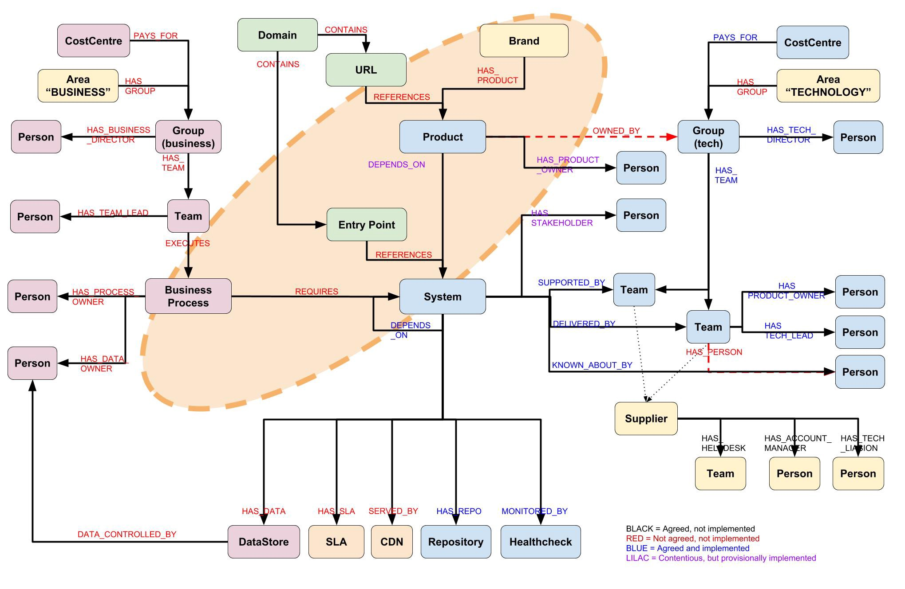
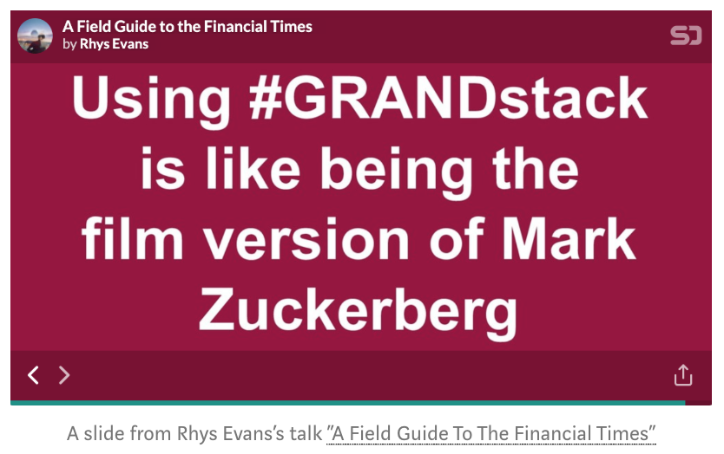
Who’s using GRANDstack & Neo4j GraphQL?
speakerdeck.com/wheresrhys/a-field-guide-to-the-financial-times
medium.com/ft-product-technology/ready-steady-crash-eeae63e89a77

Slide 74

Who’s using GRANDstack & Neo4j GraphQL?
community.neo4j.com/t/online-meetup-using-neo4j-and-graphql-to-build-human-connection/8213

Slide 75


Who’s using GRANDstack & Neo4j GraphQL?

Slide 76



foundation.graphql.org

Slide 77


GRANDstack Talks In #NODES2019
nodes2019-app.grandstack.io
neo4j.com/online-summit

Slide 78
Use code “SPEAKERFRIEND”
for a 15% discount!!!
summit.graphql.com

Slide 79

GRANDstack.io/survey

Slide 80

blog.grandstack.io

Slide 81

GRANDstack.io

Slide 82

Hunger Games Questions for
"GRANDstack:
Graphs ALL The Way Down"
Query the GraphQL Playground at nodes2019.grandstack.io to answer:
What is the title of the first session when ordered by title in ascending order?
APOC Pearls: The Best Tips & Tricks
Agile Property Graph Design Process
Aardvarks In The Cloud With Neo4j Fabric
Which speakers are presenting talks about Kafka?
Bob Loblaw and Princess Caroline
Mark Needham and Andrea Santurbano
Michael Hunger and Craig Taverner
If I like the talk about Neovis.js, what is the top recommendation for me?
Graph Visualization: Main aspects, challenges and solutions
Building Spatial Search Algorithms for Neo4j
Challenges in knowledge graph visualization Answer here: r.neo4j.com/hunger-games

Slide 83
Section Slide

Slide 84
Section Slide

Slide 85
Section Slide

